Slide 1



MERSİN UNIVERSITY
FACULTY OF MEDICINE
INTRODUCTION PRESENTATION
JULY 2021

Slide 2
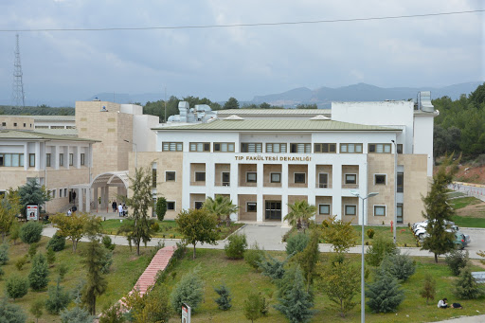
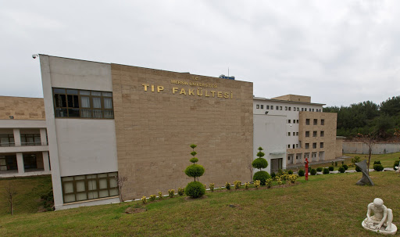
FOUNDATION
Mersin University Faculty of Medicine (MUFOM) was founded on 3rd of July 1992.
After assignment of the founder dean on 17th of April 1998, Faculty of Medicine began to act at Mersin Metropol Tower and started education in the 1998-1999 academic year.
Duration of medical education is totally 6 years in our faculty and graduates earn the degree of Medical Doctor.

Slide 3
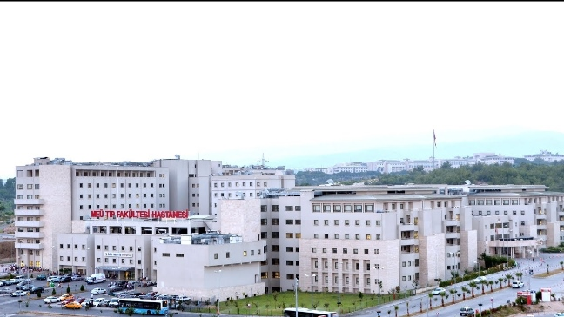
Since its foundation, MUFOM has throven in every sense in a short period of time, such as in the development of infrastructure, rapid increase in qualified academic staff, education and research, and hospital services and become an outstanding medical faculty in Turkey.
At present MUFOM has attained new buildings and has provided all technical and laboratory resources.

Slide 4
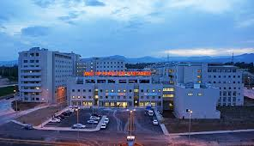
MUFOM has three main divisions as basic, medical and surgical sciences which all three are composed of totally 42 departments and 34 disciplines.
Currently, MUFOM with its 243 academic staff which is mostly consisted of professors (153 professor, 34 associate professor, 50 assistant professor and 9 instructor), 428 assistants and more than 50 administrative staff is giving education over 1600 medical students, and hospital and administrative services.

Slide 5
The hospital is serving in its new, spacious and modern building with even every diagnosis and treatment opportunities. MUFOM and the hospital has the “Quality Management System Certificate”.

Slide 6
MUFOM HOSPITAL
Mersin University Hospital has 722 patient beds on a 100.000 m2. It was completed on May 2014.
Has got 120 polyclinics for outpatients, 2 delivery rooms, 18 operating rooms (one for obstetrics), adult and pediatrics emergencies with 131 daily beds and intensive care unit with 127 bed capacity.
An Oncology Hospital with over 150 bed capacity was completed in 2020 and started serving for oncology patients.

Slide 7
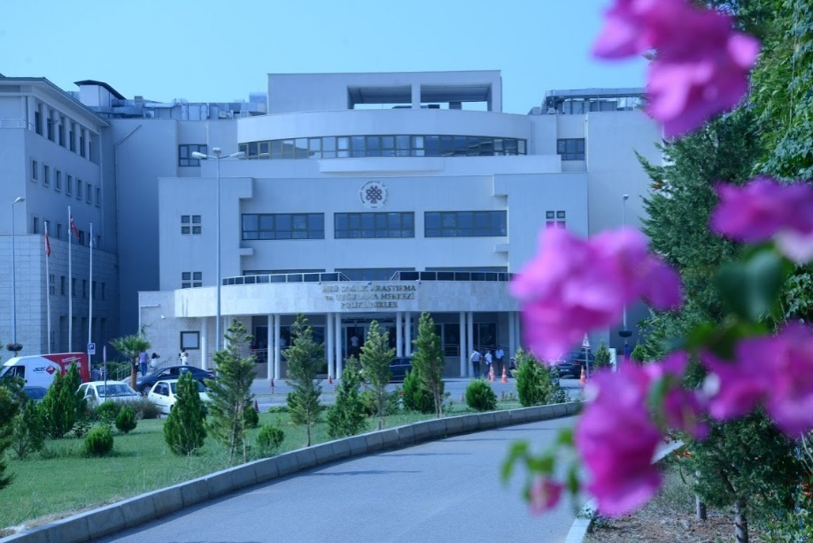
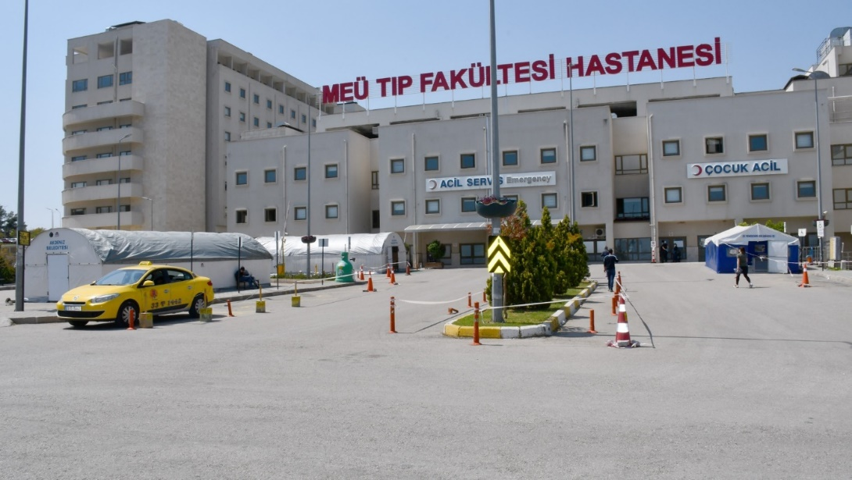

Slide 8
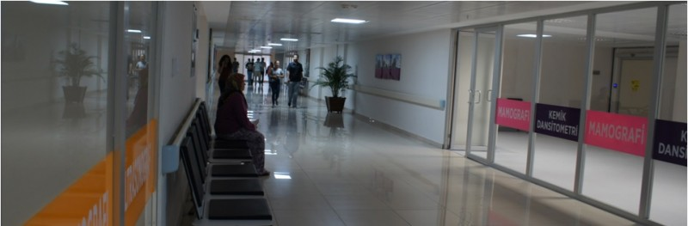
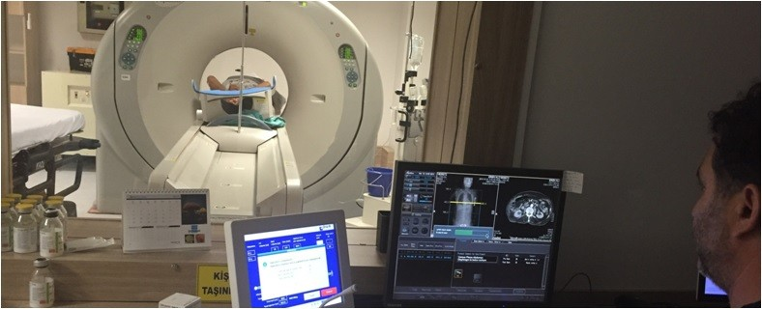
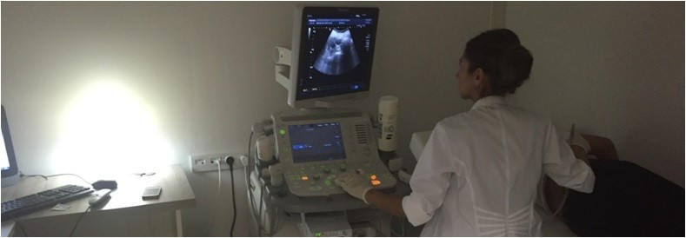

Slide 9
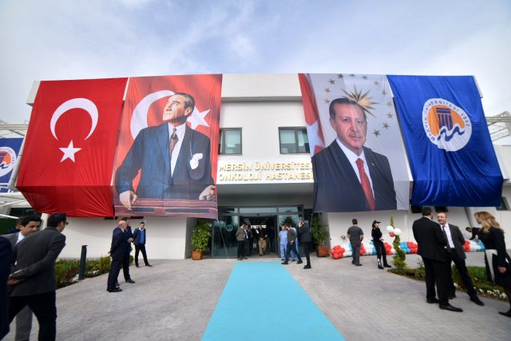
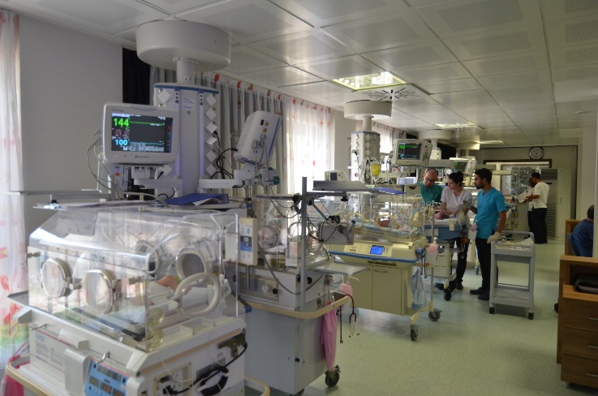
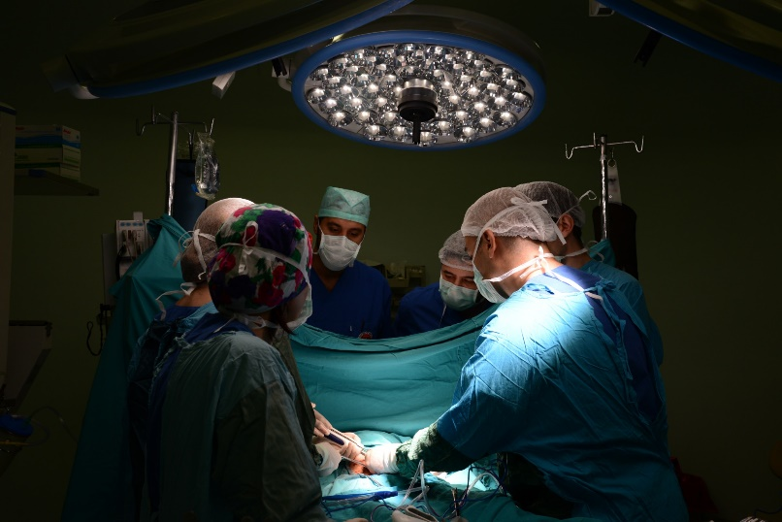
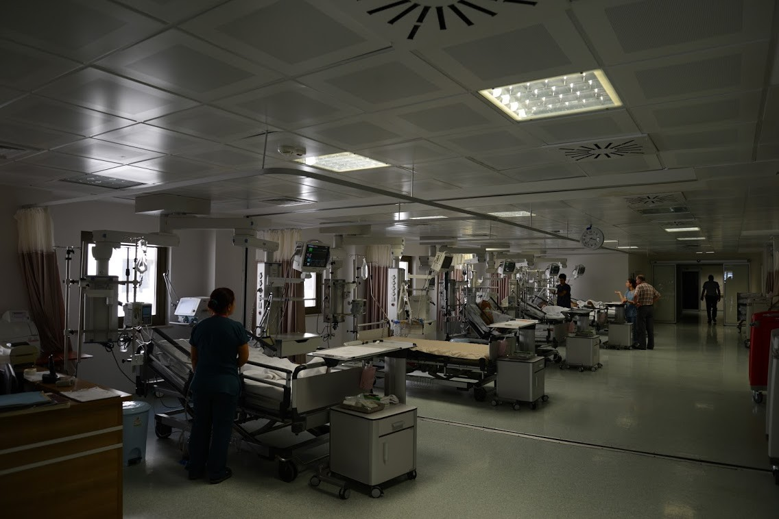

Slide 10
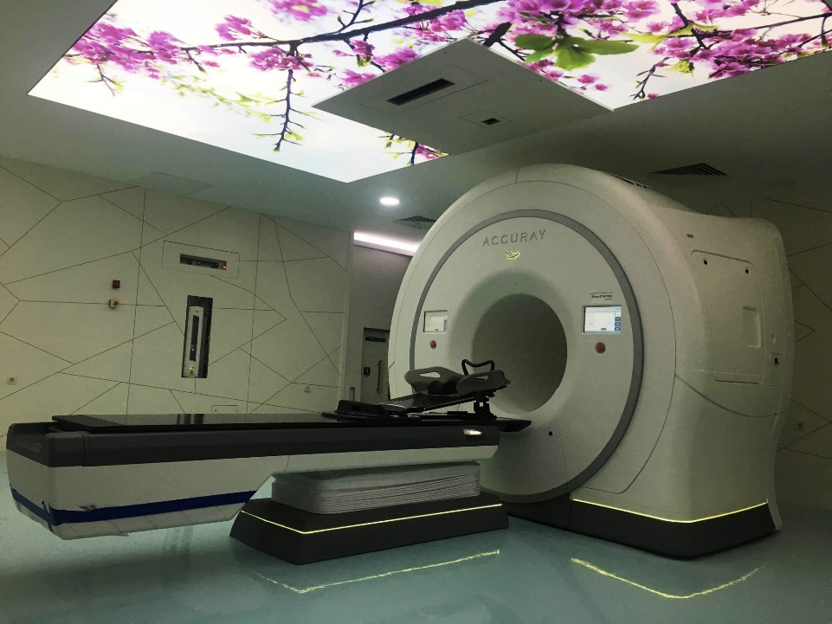
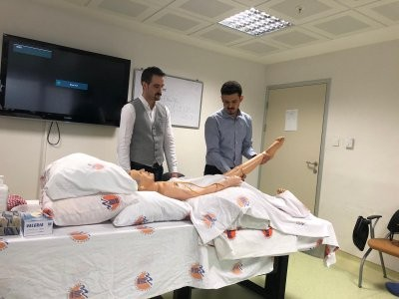
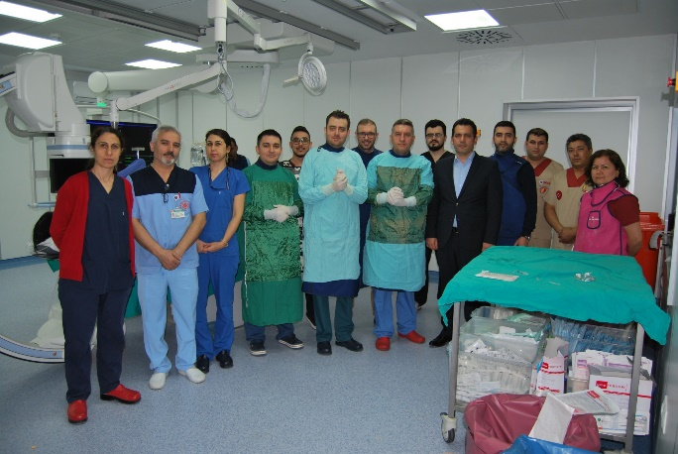
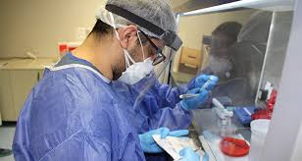

Slide 11

TSE EN ISO
Quality Management System Certificate
Fakültemizin 30.10.2003 tarihinde aldığı TSE-ISO-EN 9001-2000 Kalite Yönetim Sistemi Belgesi, belirli aralıklarla yenilenmiş ve 2010 yılından itibaren Üniversitemizin bir birimi olarak Kalite Yönetim Sistemi Belgesi devamlılığını sağlamıştır.

Slide 12
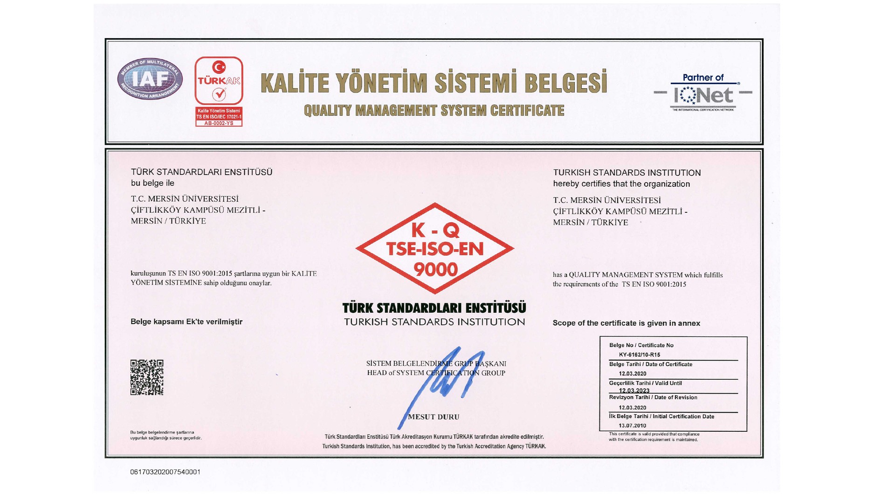

Slide 13
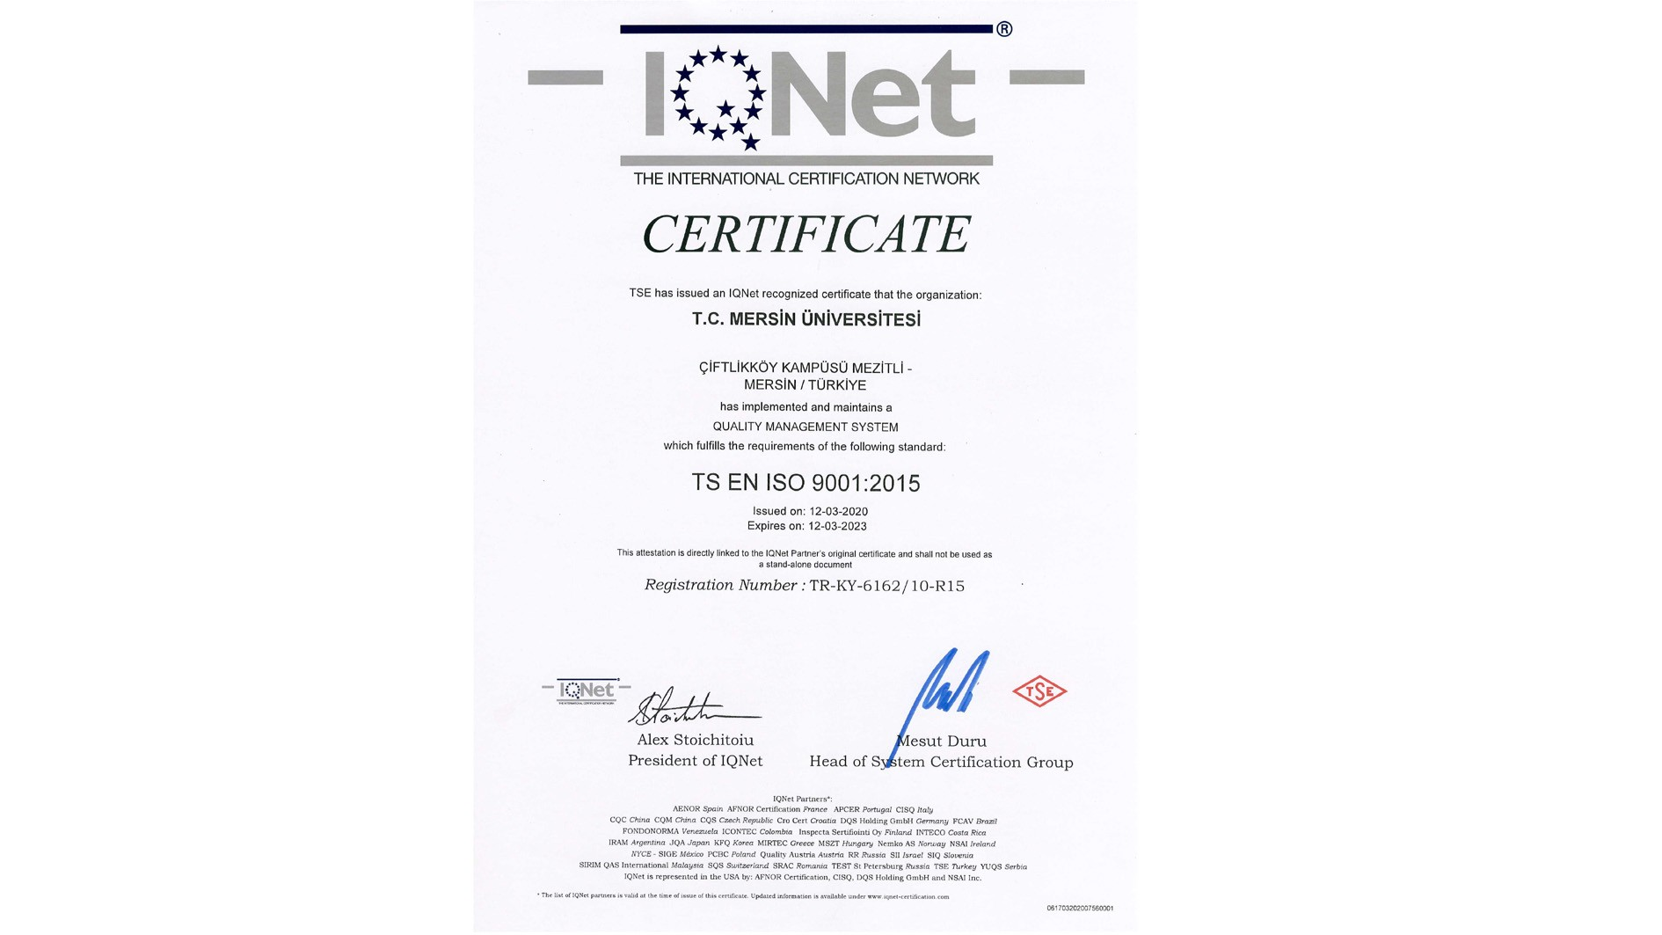

Slide 14

MUFOM VISION
To make a point of modernity and continous renewal, internalize ethical values, set quality awareness, to be recognized and preferred nationally and internationally and become a qualified faculty.

Slide 15

MUFOM MISSION
To offer a qualified service on education, research and health by continous renewal and improvement of standarts.

Slide 16
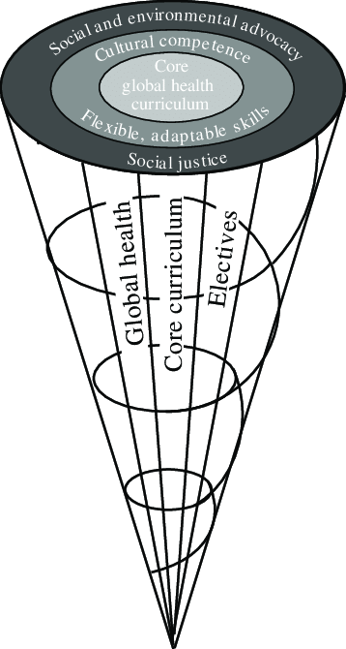
PROGRAMME AND CURRICULUM
Mersin University Faculty of Medicine is one of the prestigious and well-established medical schools accepting most successful students in Turkey. The outcome-based education program in our Faculty is horizontally and vertically integrated based on the functional properties of the organ systems. Curriculum has been designed on student centered and community oriented strategies.

Slide 17

Theoretical and practical education covers overview of basic medical sciences, normal structure and functions of the body, pathology and pathophysiology of the systems and introduction to the clinical sciences in first three years. The medical education in the fourth and fifth years consists of theoretical and practical training in all internal and surgical medical departments. Sixth year covers twelve-month internship program including ten main departments. Our university hospital provides an extensive educational and practical opportunity to our students.

Slide 18
Table. Education and Research Areas
Capacity | Classroom |  | Computer Lab. |  | Other Labs. |  | Workshop |  | Studio |  | Total
 | No | Area (m2) | No | Area (m2) | No | Area (m2) | No | Area (m2) | No | Area (m2) | No | Area (m2)
0-25 | - | - | - | - | 47 | 1776 | - | - | - | - | 47 | 1776
26-50 | 2 | 90 | - | - | 8 | 574 | - | - | - | - | 10 | 664
51-75 Kişilik | - | - | 1 | 186 | 4 | 495 | - | - | - | - | 5 | 681
76-100 Kişilik | - | - | - | - | - | - | - | - | - | - | - | -
101-150 Kişilik | - | - | - | - | - | - | - | - | - | - | - | -
151-250 Kişilik | - | - | - | - | - | - | - | - | - | - | - | -
251-Üzeri | 6 | 2913 | - | - | - | - | - | - | - | - | 6 | 2913
Total | 8 | 3003 | 1 | 186 | 59 | 2845 | - | - | - | - | 62 | 6034

Slide 19
Compulsory Courses of 1st Semester
IT Code | Course Code | Title | Category | Language | T + P + C | ECTS Credit
0011006 | YDI100 | FOREIGN LANGUAGE (ENGLISH) | Compulsory | English | 4 - 0 - 0 | 2
0011020 | DKB101 | COMITTEE BLOCK-1 | Compulsory | Turkish | 1 - 1 - 2 | 54
0011022 | AIL100 | ATATURK'S PRINCIPLES & HISTORY OF REVOLUTION | Compulsory | Turkish | 2 - 0 - 0 | 2
0011023 | TD100 | TURKISH LANGUAGE | Compulsory | Turkish | 2 - 0 - 0 | 2
 |  |  |  |  |  | 60

Slide 20
Elective Courses of 1st Semester (SEÇMELİ GRUP)
IT Code | Course Code | Title | Category | Language | T + P + C | ECTS Credit
0011024 | STP101 | MEDICAL TERMINOLOGY | Elective | Turkish | 2 - 0 - 0 | 2
0011025 | STP103 | METAPHYSICS OF LOVE | Elective | Turkish | 2 - 0 - 0 | 2
0011028 | STP109 | TENNIS | Elective | Turkish | 2 - 0 - 0 | 2
0011029 | STP111 | WATER SPORTS | Elective | Turkish | 2 - 0 - 0 | 2
0011031 | STP113 | BEACH VOLLEYBALL | Elective | Turkish | 2 - 0 - 0 | 2
0011032 | STP115 | DRAMA | Elective | Turkish | 2 - 0 - 0 | 2
0011033 | STP117 | BOCCE | Elective | Turkish | 2 - 0 - 0 | 2

Slide 21
Compulsory Courses of 2nd Semester
IT Code | Course Code | Title | Category | Language | T + P + C | ECTS Credit
0012020 | DKB201 | COMITTEE BLOCK-2 | Compulsory | Turkish | 1 - 1 - 2 | 58
0012S01 | SEC202 | ELECTIVE COURSEAt least 1 courses must be selected from this group | Elc. Pool | Turkish | 1 - 1 - 2 | 2
 |  |  |  |  |  | 60

Slide 22
Elective Courses of 2nd Semester (SEÇMELİ GRUP)
IT Code | Course Code | Title | Category | Language | T + P + C | ECTS Credit
0012023 | MYD230 | READING AND SPEAKING IN FOREIGN LANGUAGE | Elective | English | 1 - 1 - 0 | 2
0012024 | SEÇ203 | MEDICAL PHOTOGRAPHY | Elective | Turkish | 1 - 1 - 0 | 2
0012025 | STP201 | ART AND BIOETICHS | Elective | Turkish | 2 - 0 - 0 | 2
0012027 | STP205 | INTRODUCTION TO SOCIOLOGY | Elective | Turkish | 2 - 0 - 0 | 2

Slide 23
Compulsory Courses of 3rd Semester
IT Code | Course Code | Title | Category | Language | T + P + C | ECTS Credit
0013020 | DKB301 | COMMITTEE BLOCK-3 | Compulsory | Turkish | 1 - 1 - 2 | 58
0013S01 | SEC301 | ELECTIVE COURSEAt least 1 courses must be selected from this group | Elc. Pool | Turkish | 1 - 1 - 2 | 2
 |  |  |  |  |  | 60

Slide 24
Elective Courses of 3rd Semester (SEÇMELİ GRUP)
IT Code | Course Code | Title | Category | Language | T + P + C | ECTS Credit
0013010 | STP320 | HISTORY OF SCIENCE | Elective | Turkish | 2 - 0 - 0 | 0
0013012 | STP340 | MEDICAL SOCIOLOGY | Elective | Turkish | 2 - 0 - 0 | 2
0013022 | STP360 | MEDICAL TRANSLATION (ENGLISH) | Elective | Turkish | 2 - 0 - 0 | 2
0013023 | STP301 | SCIENCE AND PEUDOSCIENCE | Elective | Turkish | 2 - 0 - 0 | 2
0013024 | STP303 | BIOETHICS COURSE IN FILMS | Elective | Turkish | 2 - 0 - 0 | 2
0013026 | STP307 | HEALTH M COMMUNİCATİON SKİLLS | Elective | Turkish | 2 - 0 - 0 | 2
0013027 | STP309 | ORYANTIRING | Elective | Turkish | 2 - 0 - 0 | 2
0013029 | STP313 | INTERNATIONAL KITCHEN-1 | Elective | Turkish | 2 - 0 - 0 | 2

Slide 25
Compulsory Courses of 4th Semester
IT Code | Course Code | Title | Category | Language | T + P + C | ECTS Credit
0014001 | IH401 | INTERNAL MEDICINE | Compulsory | Turkish | 1 - 1 - 2 | 11
0014002 | CSH401 | PEDIATRICS | Compulsory | Turkish | 1 - 1 - 2 | 13
0014003 | GC401 | GENERAL SURGERY | Compulsory | Turkish | 1 - 1 - 2 | 11
0014004 | KHD401 | OBSTETRICS AND GYNAECOLOGY | Compulsory | Turkish | 1 - 1 - 2 | 9
0014009 | ÇC401 | PEDIATRIC SURGERY | Compulsory | Turkish | 1 - 1 - 2 | 3
0014010 | ÜR401 | UROLOGY | Compulsory | Turkish | 1 - 1 - 2 | 5
0014011 | ENF401 | INFECTIOUS DISEASES | Compulsory | Turkish | 1 - 1 - 2 | 5
0014012 | RNT401 | RADIODIAGNOSTIC MEDICINE | Compulsory | Turkish | 1 - 1 - 2 | 3
 |  |  |  |  |  | 60

Slide 26
Compulsory Courses of 5th Semester
IT Code | Course Code | Title | Category | Language | T + P + C | ECTS Credit
0015001 | AT501 | FORENSIC MEDICINE | Compulsory | Turkish | 1 - 1 - 2 | 3
0015002 | AR502 | ANESTHESIOLOGY AND REANIMATION | Compulsory | Turkish | 1 - 1 - 2 | 3
0015005 | FTR505 | PHYSICAL MEDICINE AND REHABILITATION | Compulsory | Turkish | 1 - 1 - 2 | 3
0015007 | GÖZ507 | OPTHALMOLOGY | Compulsory | Turkish | 1 - 1 - 2 | 3
0015008 | HS508 | PUBLIC HEALTH | Compulsory | Turkish | 1 - 1 - 2 | 5
0015009 | KBB509 | OTORHINOLARYNGOLOGY | Compulsory | Turkish | 1 - 1 - 2 | 5
0015010 | NÖR510 | NEUROLOGY | Compulsory | Turkish | 1 - 1 - 2 | 5
0015011 | ORT511 | ORTOPAEDICS AND TRAUMATOLOGY | Compulsory | Turkish | 1 - 1 - 2 | 5
0015013 | PSK513 | PSYCHIATRY | Compulsory | Turkish | 1 - 1 - 2 | 5
0015016 | GÖC506 | THORACIC SURGERY | Compulsory | Turkish | 1 - 1 - 2 | 3
0015017 | KDC516 | CARDIOVASCULAR SURGERY | Compulsory | Turkish | 1 - 1 - 2 | 1
0015018 | NŞ503 | NEUROSURGERY | Compulsory | Turkish | 1 - 1 - 2 | 3
0015019 | PRE512 | PLASTIC RECONSTRUCTIVE AND AESTHETIC SURGERY | Compulsory | Turkish | 1 - 1 - 2 | 1
0015021 | DER517 | DERMATOLOGY | Compulsory | Turkish | 1 - 1 - 2 | 5
0015022 | GH518 | CHEST DISEASES | Compulsory | Turkish | 1 - 1 - 2 | 5
0015023 | KAR519 | CARDIOLOGY | Compulsory | Turkish | 1 - 1 - 2 | 5
 |  |  |  |  |  | 60

Slide 27
Compulsory Courses of 6th Semester
IT Code | Course Code | Title | Category | Language | T + P + C | ECTS Credit
0016001 | İH601 | INTERNAL MEDICINE | Compulsory | Turkish | 1 - 1 - 2 | 10
0016002 | ÇSH602 | PEDIATRICS | Compulsory | Turkish | 1 - 1 - 2 | 10
0016003 | KHD603 | OBSTETRICS AND GYNAECOLOGY | Compulsory | Turkish | 1 - 1 - 2 | 5
0016004 | HS604 | PUBLIC HEALTH | Compulsory | Turkish | 1 - 1 - 2 | 5
0016005 | AP605 | EMERGENCY DEPARTMENT | Compulsory | Turkish | 1 - 1 - 2 | 10
0016006 | PSK606 | PSYCHIATRY | Compulsory | Turkish | 1 - 1 - 2 | 5
0016007 | EL607 | ELECTIVE | Compulsory | Turkish | 1 - 1 - 2 | 5
0016008 | GC608 | GENERAL SURGERY | Compulsory | Turkish | 1 - 1 - 2 | 5
0016009 | AH609 | FAMILY MEDICINE | Compulsory | Turkish | 1 - 1 - 2 | 5
 |  |  |  |  |  | 60

Slide 28
2019-2020 ACADEMIC YEAR
Total Student Count
Phase | Female | Male | Total
1 | 149 | 186 | 335
2 | 116 | 160 | 276
3 | 116 | 138 | 254
4 | 133 | 150 | 283
5 | 98 | 130 | 228
6 | 111 | 118 | 229
Total | 723 | 882 | 1605
2020-2021 ACADEMIC YEAR
Total Student Count
Phase | Female | Male | Total
1 | 119 | 164 | 283
2 | 139 | 176 | 315
3 | 113 | 157 | 270
4 | 120 | 142 | 262
5 | 127 | 149 | 276
6 | 97 | 124 | 221
Total | 715 | 912 | 1627

Slide 29
FOREIGN STUDENTS by COUNTRY
2020-2021
Country | Student No
Afghanistan | 9
Germany | 5
Azerbaijan | 24
Indonesia | 1
Bulgaria | 2
Palastine | 3
Kazakistan | 1
Irak | 8
Iran | 37
Turkish Republic of Northern Cyprus | 14
Kongo | 1
Egypt | 2
Syria | 12
Turkmenistan | 1
Ukraine | 1
Jordan | 4
Yemen | 2
United States of America | 2
Mogolistan | 1
Sudan | 1
Total | 131

Slide 30
2020-2021
Student/Faculty Ratio
Phase | Student No (A) | Faculty No (B) | Ratio (A/B)
1 | 283 | 52 | 5,44
2 | 315 | 46 | 6,84
3 | 270 | 115 | 2,34
4 | 262 | 75 | 3,49
5 | 276 | 87 | 3,17
6 | 221 | 124 | 1,78
Total(*) | 1627 | 499 | 3,26
(*) Total student and lecturer faculty numbers are given.

Slide 31
INTERNATIONAL AGREEMENTS
University | Country
Universita Degli Studi di Foggia Universita Degli Studi di Genova Seconda Universita Degli Studi di Napoli University of Pisa Sapienza Universita di Roma | Italy
Justus-Liebig-Universitat Giessen | Germany
Tyumen State Medical Academy | Russia
Trakia University | Bulgaria
Avicenna Tajik State Medical University | Tacjkistan
University "Dunarea de Jos" of Galati | Romania

Slide 32
ERASMUS and
FARABİ PRAGRAMMES

Slide 33
GRADUATES BY YEAR SINCE FOUNDATION
Year | Graduates
2003-2004 | 14
2004-2005 | 31
2005-2006 | 42
2006-2007 | 34
2007-2008 | 47
2008-2009 | 66
2009-2010 | 76
2010-2011 | 46
2011-2012 | 95
2012-2013 | 65
2013-2014 | 97
2014-2015 | 108
2015-2016 | 120
2016-2017 | 147
2017-2018 | 171
2018-2019 | 177
Total | 1336

Slide 34

MUFOM BOARDS, COMMITTIES and COMMISSIONS
FACULTY BOARD
FACULTY ADMINISTRATIVE BOARD
PROGRAMM DEVELOPMENT BOARD
QUALİTY COMMITTEE
STUDENT QUALITY COMISSION
STUDENT FEEDBACK COMMISSION
STUDENT SOCIAL ACTIVITIES COMMISSION
CARRIER PLAN COMMISSION (FOR STUDENTS)
SCIENTIFIC COMMISSION
STUDENT COUNSELOR COMMISSION
ALUMNIE COMMISSION
STUDENT SCHOLAR COMMISSION

Slide 35
Program Evaluation Diagram

Slide 36
PMGK Rapor Hazırlama
Alt Komisyonu
Bağlam
Girdi
Süreç
Ürün
Eğitim öğretim amaç öğrenim hedeflerine ulaşıldı mı?
Öğrenci akademik başarı durumları nasıldır?
Öğrencilerin geçme/kalma oranları nasıldır?
Mezunların sahada karşılaştıkları bilgi, beceri ve tutum ihtiyaçları eğitim programı ile karşılanabilmekte midir?
Ne gibi önlemler alınabilir?
Eğitim süreci
Dersler zamanında işleniyor mu?
Hedeflere ulaşmak için uygun eğitim öğretim yöntemleri kullanılıyor mu?
Eğitim programı ne kadar iyi uygulanıyor?
Eğitim sürecini etkileyen riskler ve fırsatlar nelerdir?
Ne gibi önlemler alınabilir?
Eğitim programını işletebilmek için insan kaynakları yeterli mi?
Eğitim programını işletebilmek için donanım yeterli mi?
Eğitim programını işletebilmek için alt yapı olanakları yeterli mi?
Ne gibi önlemler alınabilir?
Müfredat ve amaç öğrenim hedefleri;
Toplumsal ihtiyaçları karşılamakta mıdır?
UÇEP ile uyumlu mudur?
TYYÇ gözetilmiş midir?
Mezunların sahadaki ihtiyaçlarını karşılamakta mıdır?
Ne gibi önlemler alınabilir?
Kurullar
Komisyonlar
Öz Değerlendirme Kurulu
Lisans Eğitimi Koordinatörler Kurulu
Mezuniyet Sonrası Eğitim Koordinasyon Kurulu
Yayın ve Dökümantasyon Kurulu
Mezun Komisyonu
Sürekli Mesleki Gelişim Etkinlik Komisyonu
Geribildirim Anket Komisyonu
Stratejik Plan Komisyonu
Stajyer ve İntörn Yönergesi Komisyonu
Öğrenci Kalite Komisyonu
Kariyer Günleri Düzenleme Komisyonu
Öğrenci Danışmanlığı Koordinasyon Komisyonu
Akademik Faaliyetlere Gönüllü Öğrenci Katılımı (AFGÖK) Komisyonu
Ölçme ve Değerlendirme Komisyonu
Yıllık gelişim ara değerlendirme Öz değerlendirme raporu, UTEAK önerileri
1 -30 Eylül arası
Eğitim değerlendirme raporu
1 -30 Eylül arası
Kurul/Komisyon/Toplantı raporu (Eğitimle ilgili faaliyet, karar, görüş, öneri içeren)
Kurul/Komisyon/Toplantı raporu (Eğitimle ilgili faaliyet, karar, görüş, öneri içeren), Mezun izleme anketi raporu
1 -30 Eylül arası
Kurul/Komisyon/Toplantı raporu (Eğitimle ilgili faaliyet, karar, görüş, öneri içeren)
1 -30 Eylül arası
Kurul/Komisyon/Toplantı raporu (Eğitimle ilgili faaliyet, karar, görüş, öneri içeren),Stratejik Plan Raporu
Kurul/Komisyon/Toplantı raporu (Eğitimle ilgili faaliyet, karar, görüş, öneri içeren) Anket ve Dilek ve Öneri Kutusu Sonuçları Raporu
1 -30 Eylül arası
Kurul/Komisyon/Toplantı raporu (Eğitimle ilgili faaliyet, karar, görüş, öneri içeren)
Kurul/Komisyon/Toplantı raporu (Eğitimle ilgili faaliyet, karar, görüş, öneri içeren)
1 -30 Eylül arası
Kurul/Komisyon/Toplantı raporu (Eğitimle ilgili faaliyet, karar, görüş, öneri içeren)
1 -30 Eylül arası
Kurul/Komisyon/Toplantı raporu (Eğitimle ilgili faaliyet, karar, görüş, öneri içeren)
1 -30 Eylül arası
Kurul/Komisyon/Toplantı raporu (Eğitimle ilgili faaliyet, karar, görüş, öneri içeren)
1 -30 Eylül arası
Kurul/Komisyon/Toplantı raporu (Eğitimle ilgili faaliyet, karar, görüş, öneri içeren)
1 -30 Eylül arası
DEKANLIK
Koordinatörlükler
Erasmus, Farabi Ve Mevlana Koordinatörlükleri
Kurul/Komisyon/Toplantı raporu (Eğitimle ilgili faaliyet, karar, görüş, öneri içeren)
1 -30 Eylül arası
İdari birimler
Öğrenci işleri
Personel
Akademik, idari personel sayısı
Taşınır kayıtlı stok
Eğitimle alakalı kayıtlı taşınır durum raporu
Stratejik Plan Raporu oluşturulduğunda
Talep edildiğinde
Talep edildiğinde
Mezun ve mevcut öğrenci sayısı (yıllara göre)
Talep edildiğinde
Kurul/Komisyon/Toplantı raporu (Eğitimle ilgili faaliyet, karar, görüş, öneri içeren)
1 -30 Eylül arası
Kurul/Komisyon/Toplantı raporu (Eğitimle ilgili faaliyet, karar, görüş, öneri içeren)
1 -30 Eylül arası
1 -30 Eylül arası
1 -30 Eylül arası
Sosyal Kültürel Aktiviteler Komisyonu
Fakülte Sekreterliği
Faaliyet Bilgi Sistemi veri örneği
FBS veri girişi yapıldığında
Kalite Birimi
BİLGİ İÇİN
BİLGİ İÇİN
Taslak Rapor
Düzenleme
PMGK
Nihai Rapor
DEKANLIK
Fakülte Kurulu
Gereği

Slide 37
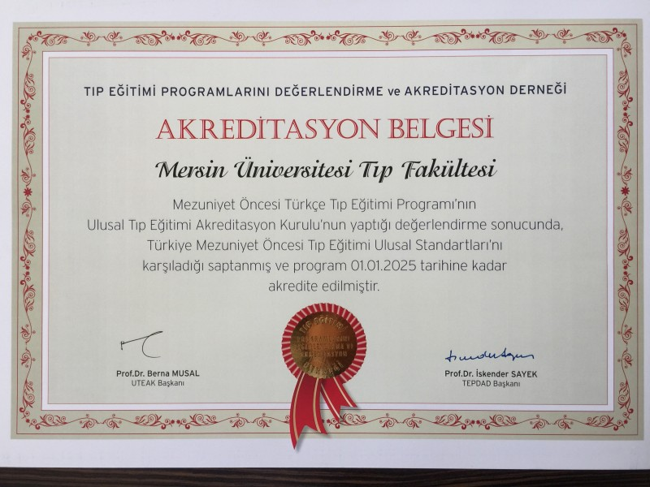
MUFOM has been accredited in 2012 and then in 2019 again by the “Association for Evaluation and Accreditation of Medical Education Programs” (TEPDAD).

Slide 38


RE-ACCREDİTED FACULTY
MUFOM is one of 23 medical faculties
re-accredited in between more than 100 medical faculties in Turkey.

Slide 39
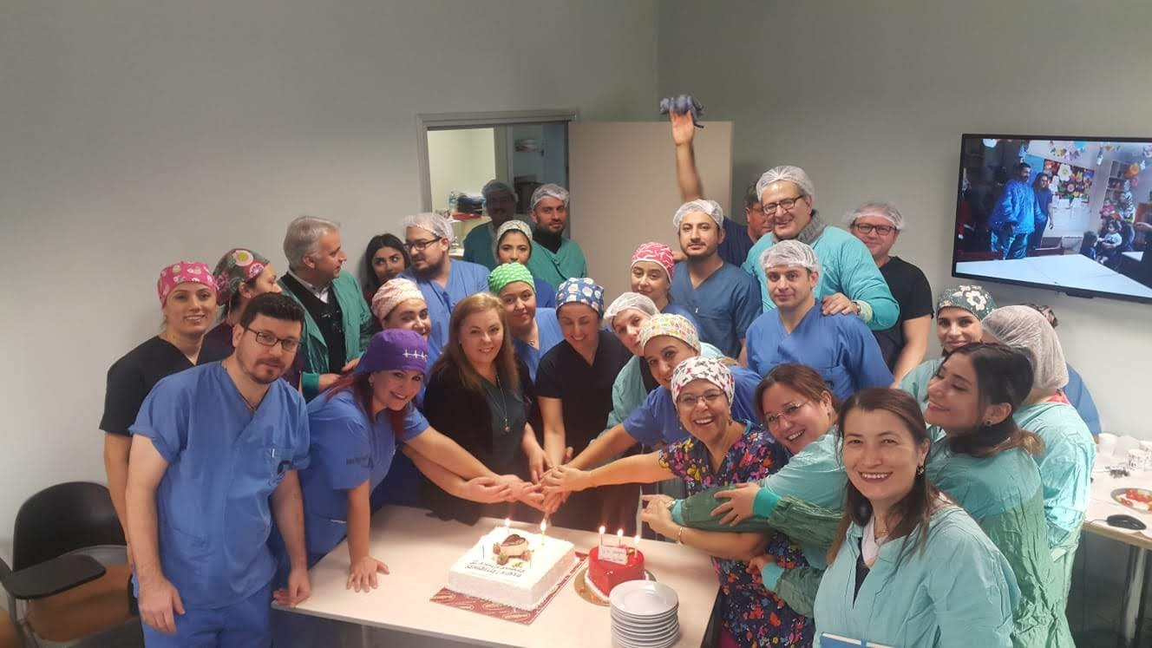

ACCREDITED DEPARTMENTS of MUFOM
Anesthesiology and Reanimation
General Surgery
Cardiology
Orthopaedics and Trauma Surgery
Algology
Radiology

Slide 40
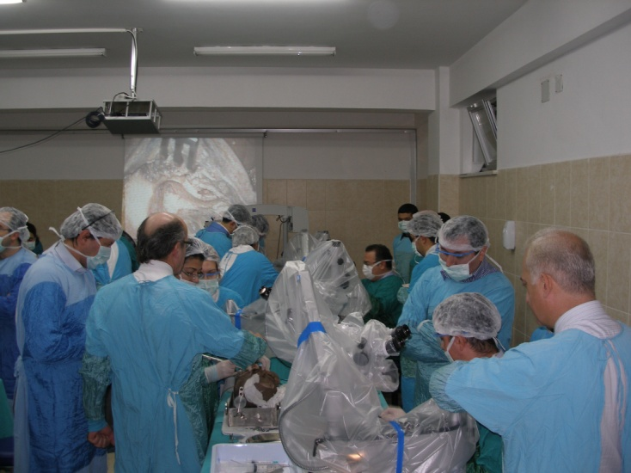
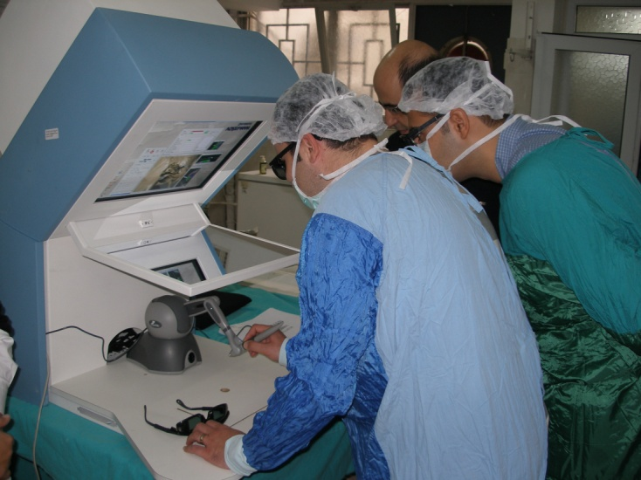
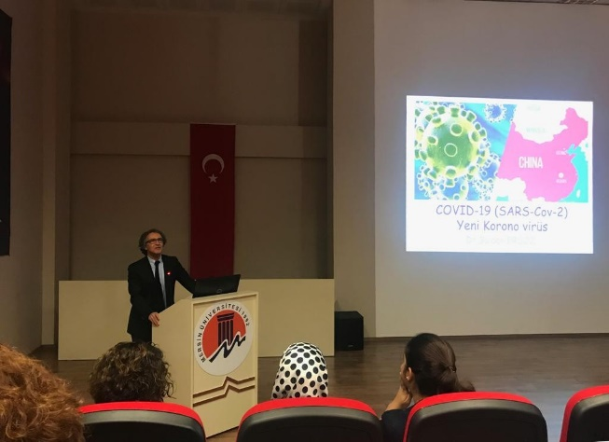
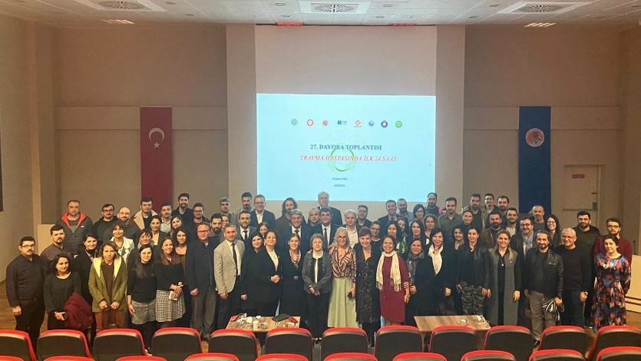
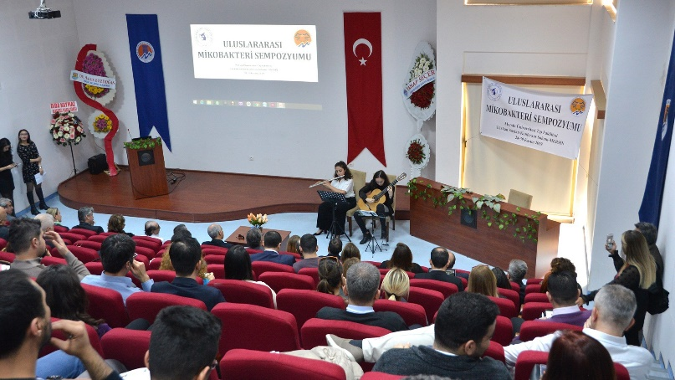
SCIENTIFIC MEETINGS

Slide 41
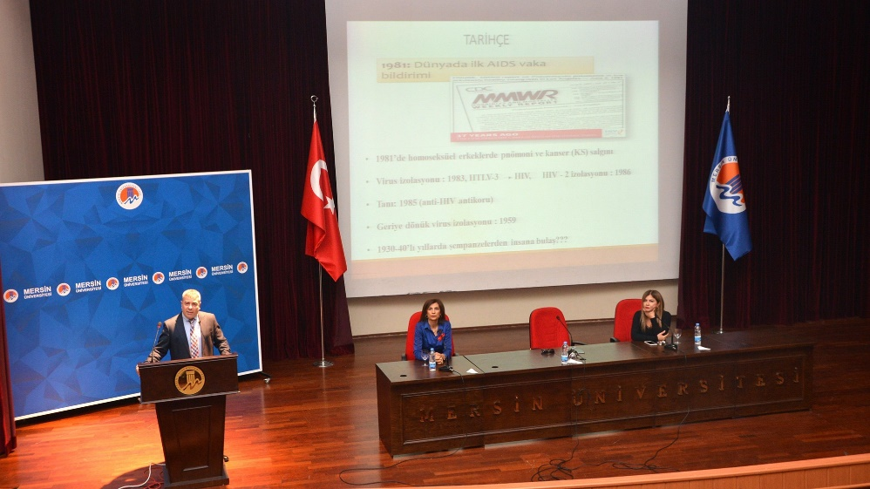
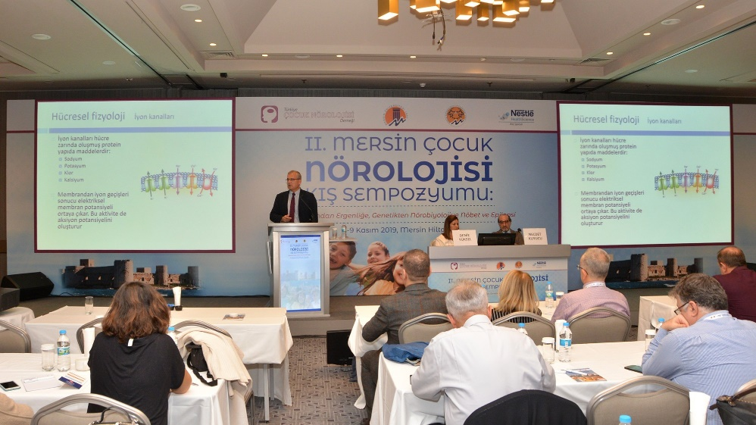
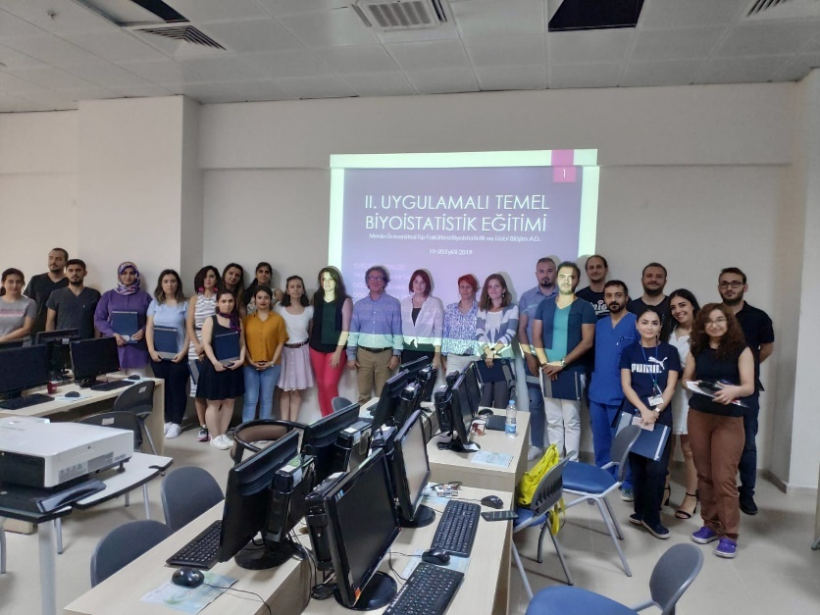
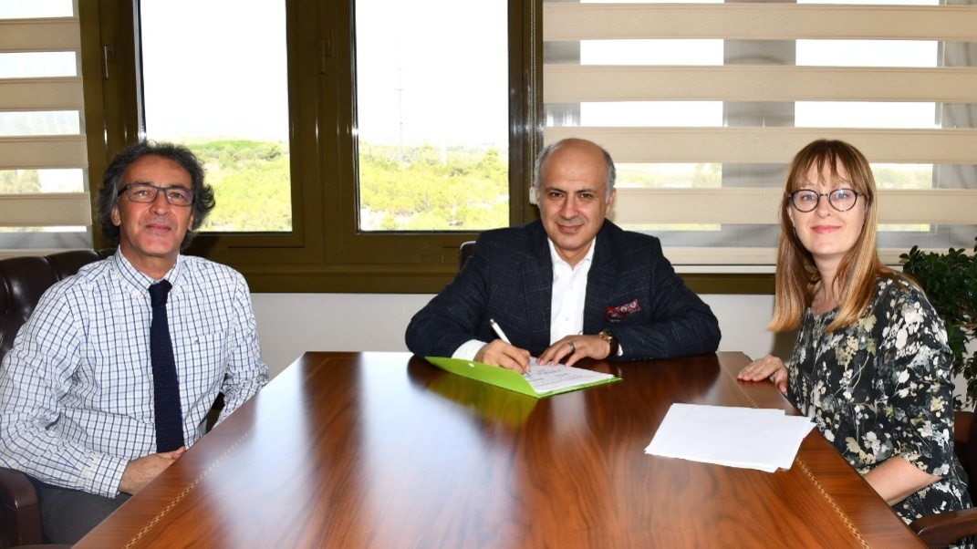

Slide 42
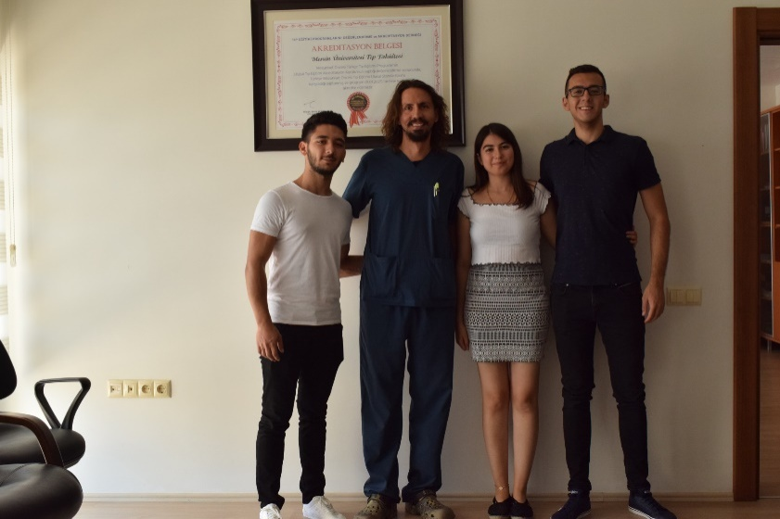
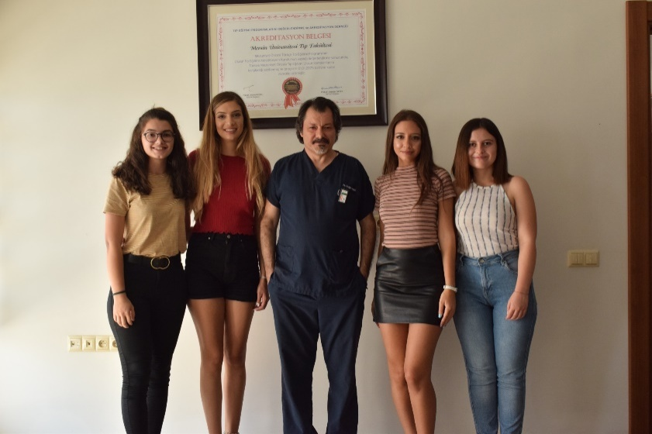
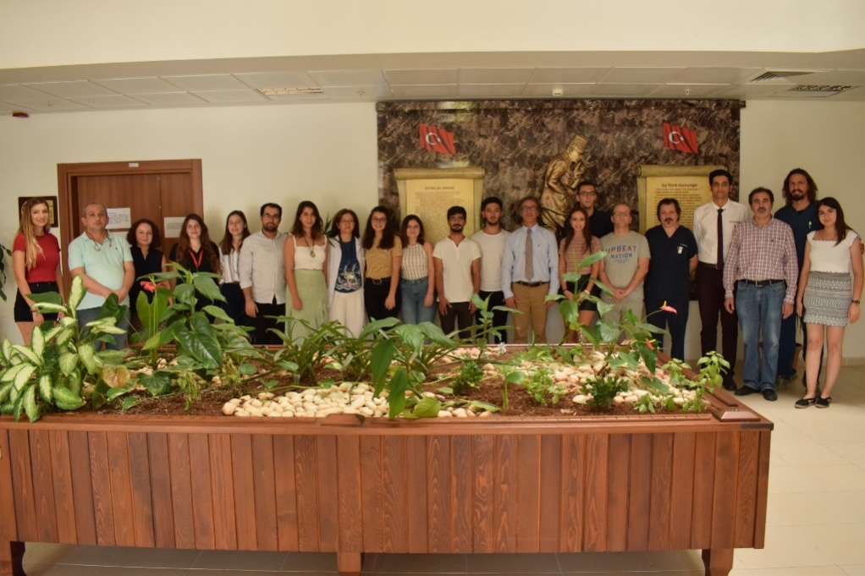
SCIENTIFIC PROJECTS WITH STUDENTS

Slide 43
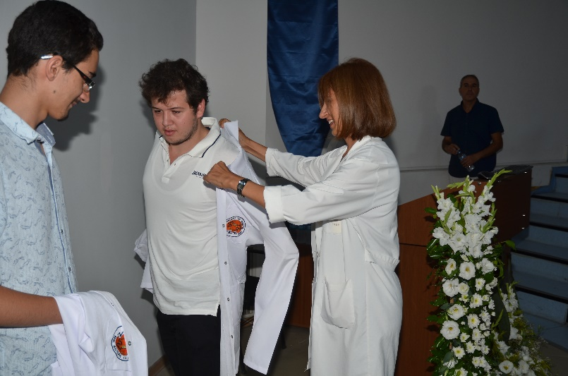
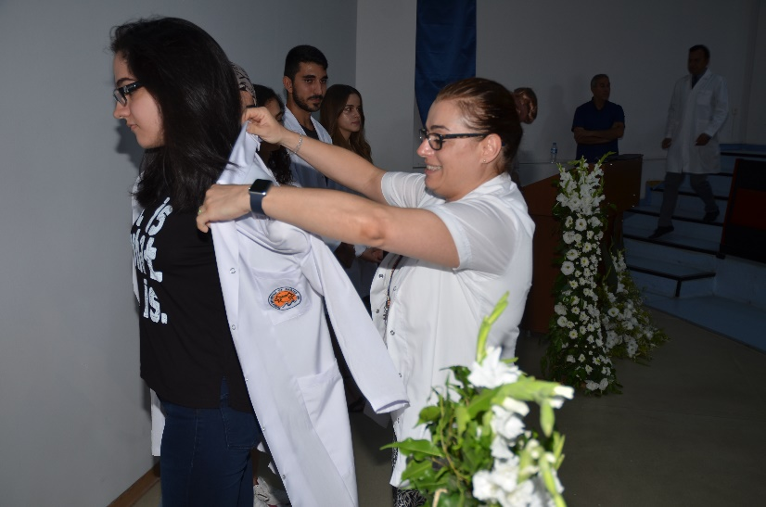
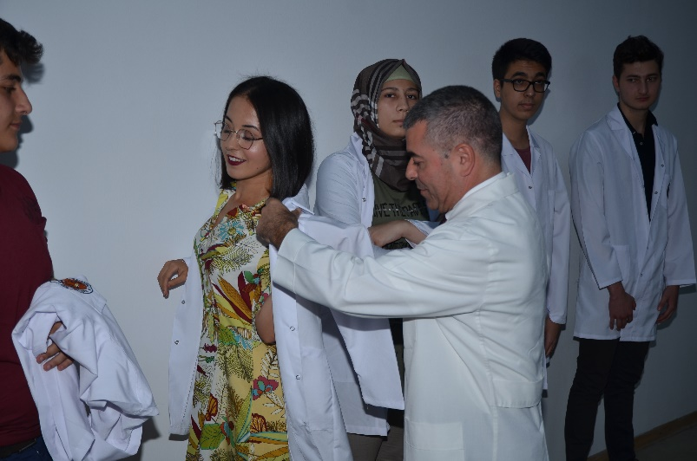
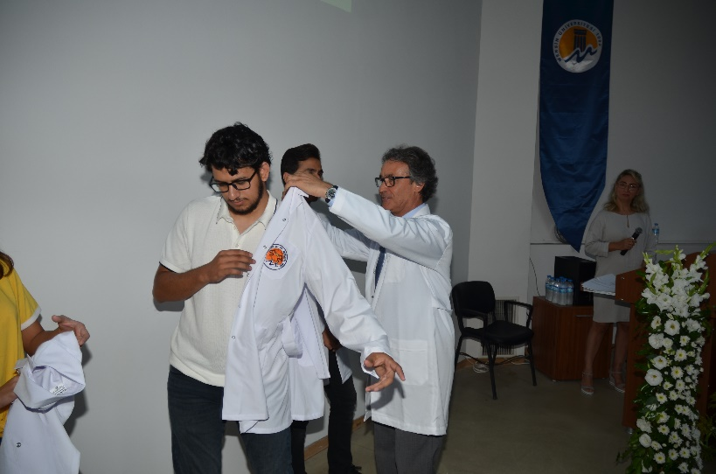
WHITE COAT CEREMONY

Slide 44
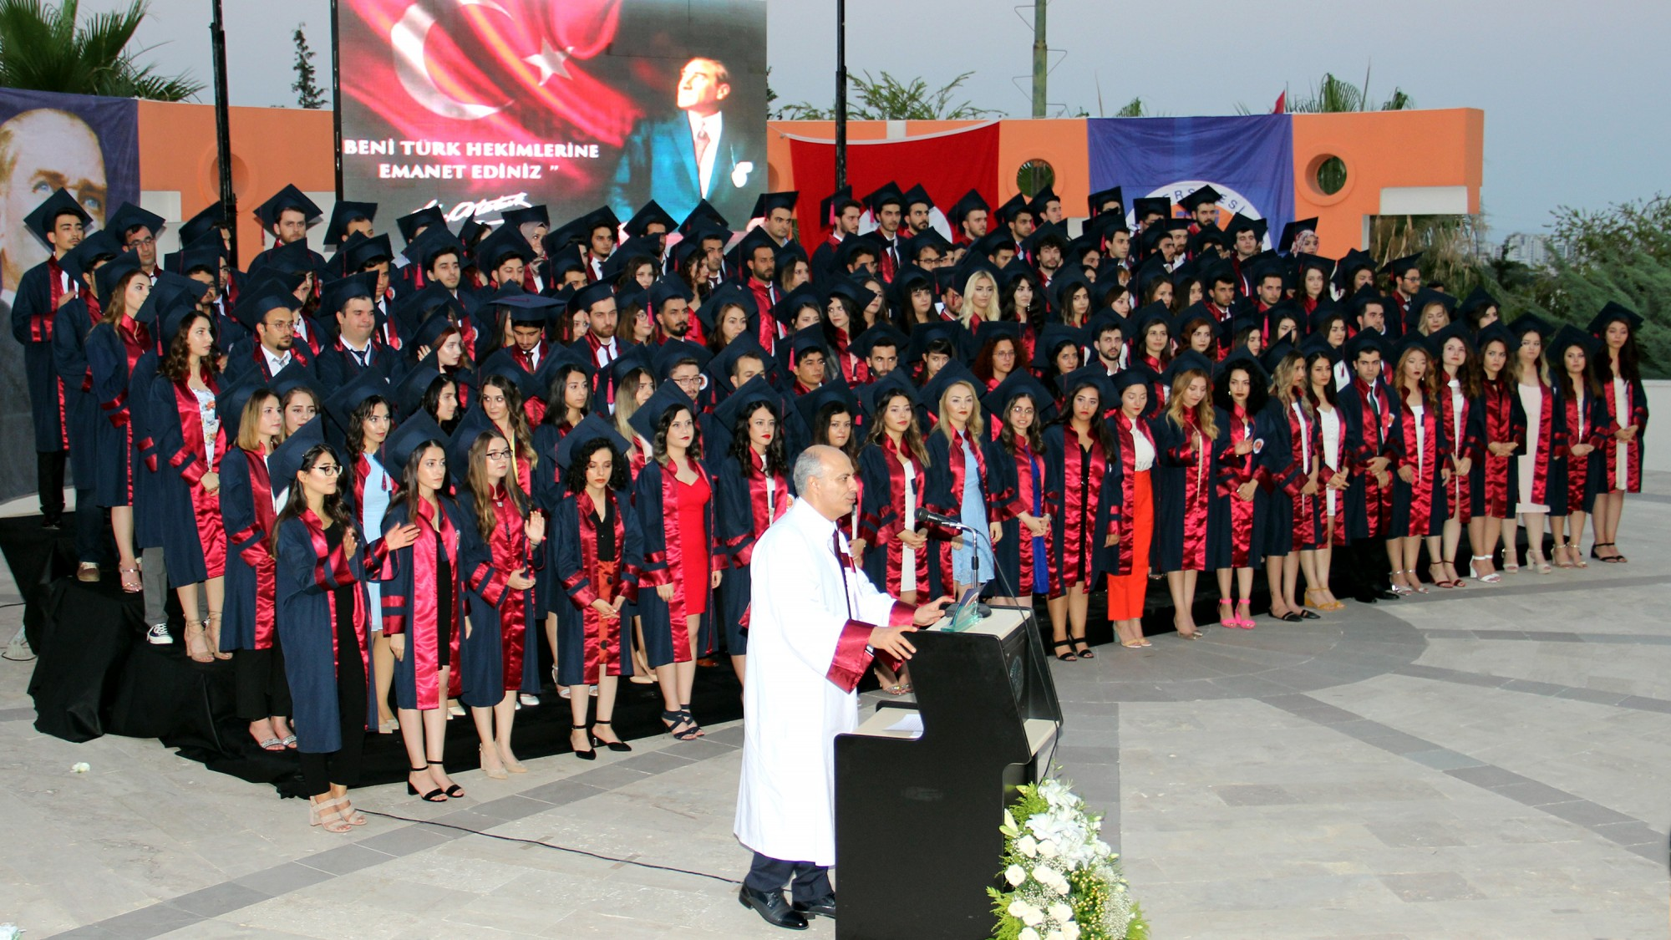
COMMENCEMENTS

Slide 45
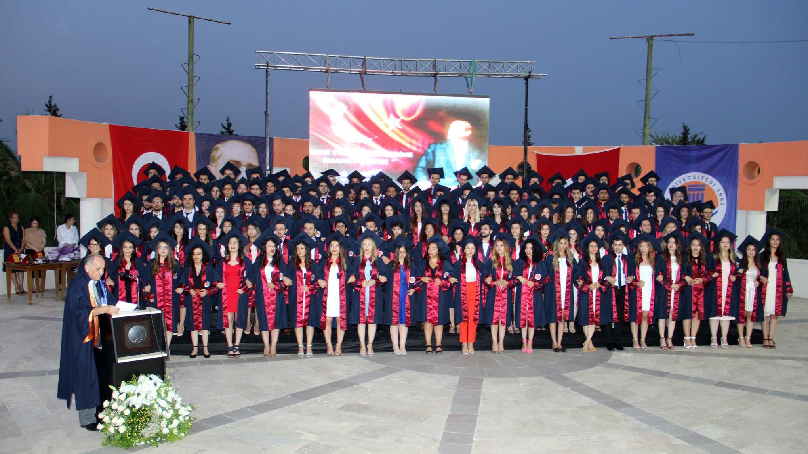
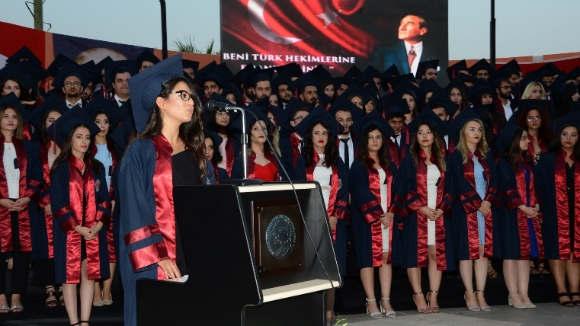
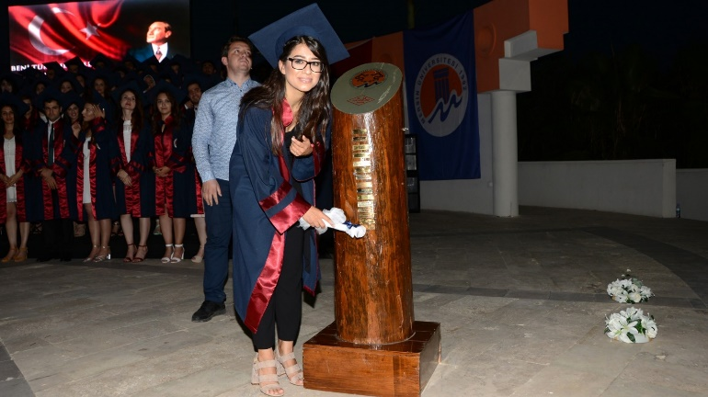

Slide 46
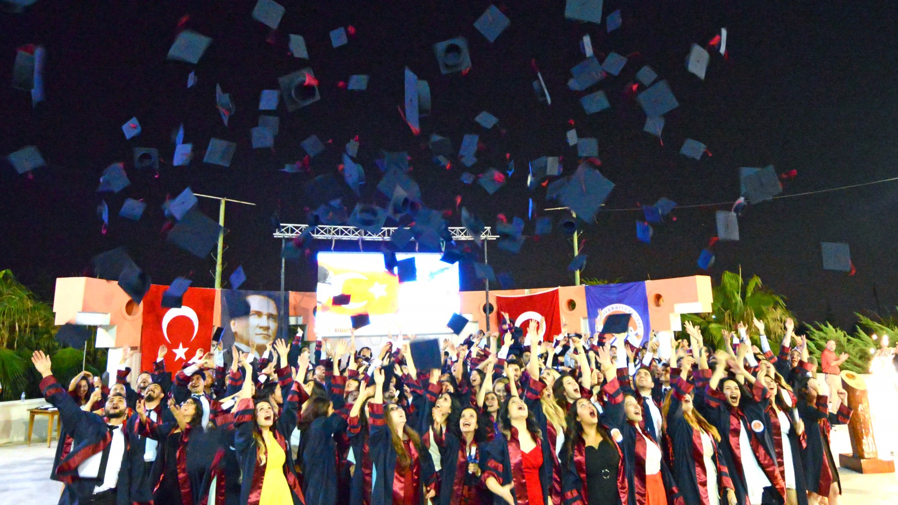

Slide 47
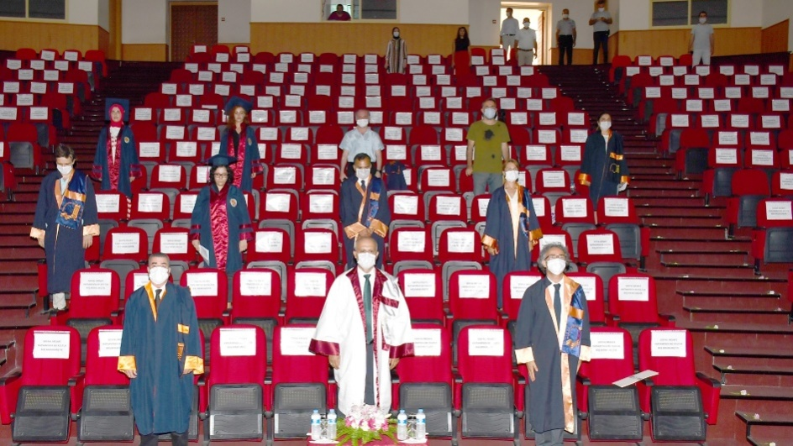
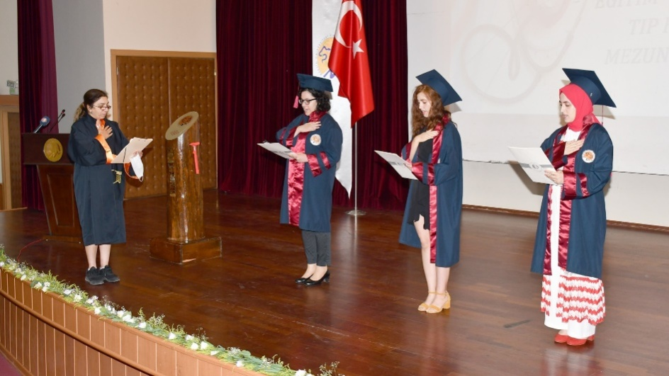
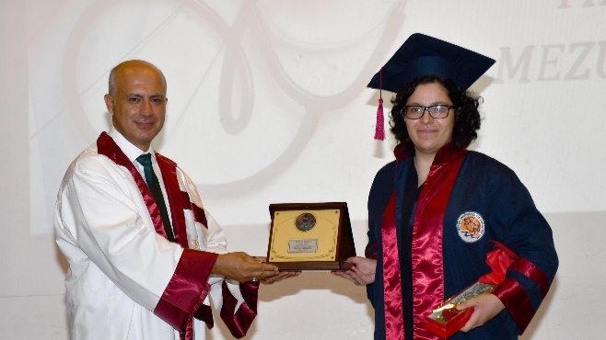
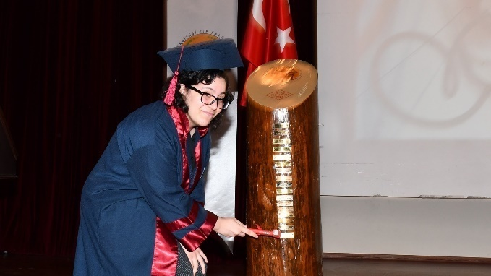
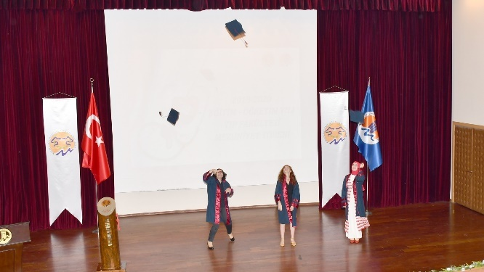
COMMENCEMENT 2019-2020

Slide 48
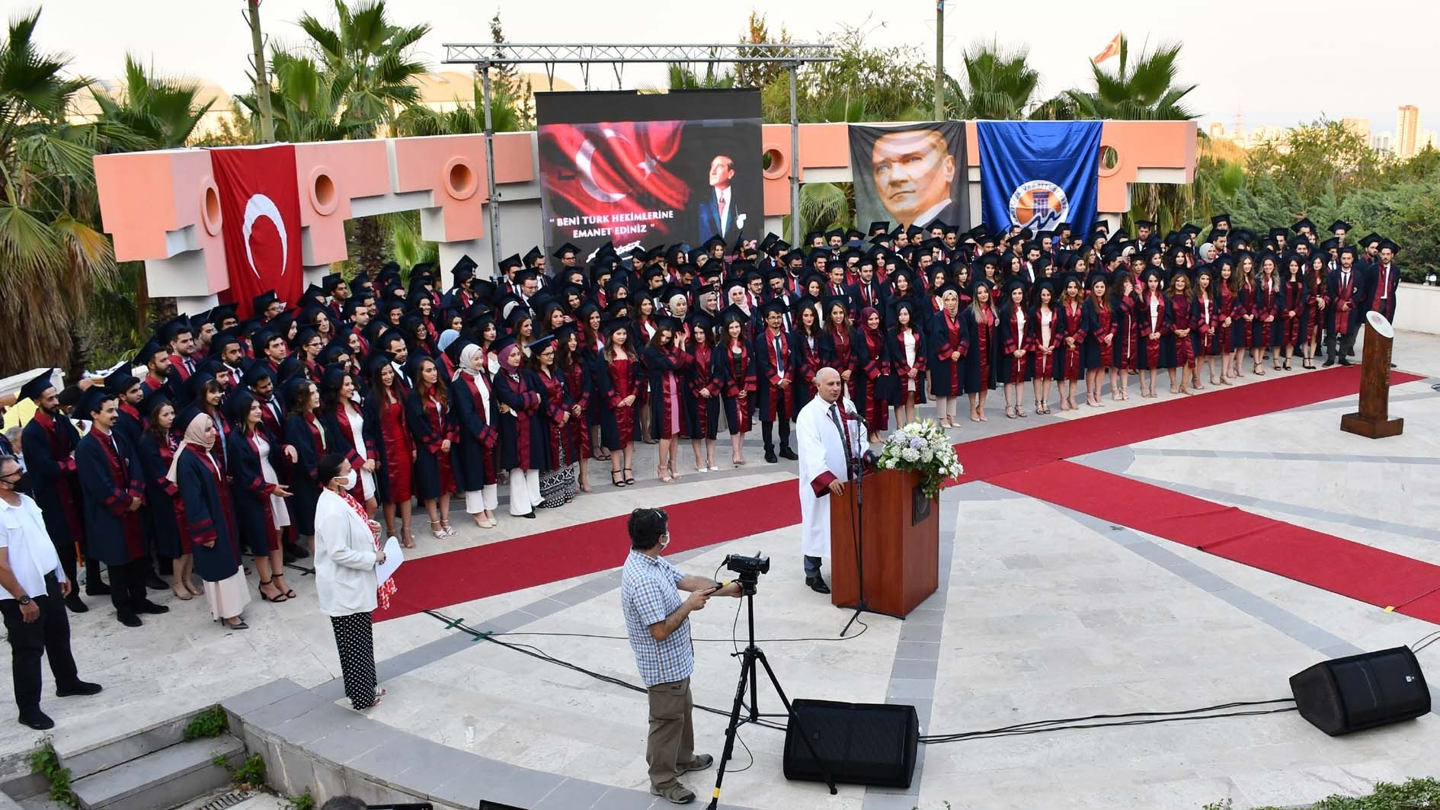
COMMENCEMENT 2020-2021

Slide 49


Slide 50


YOU’RE WELLCOME TO MERSİN UNIVERSITY FACULTY OF MEDICINE

