Slide 1
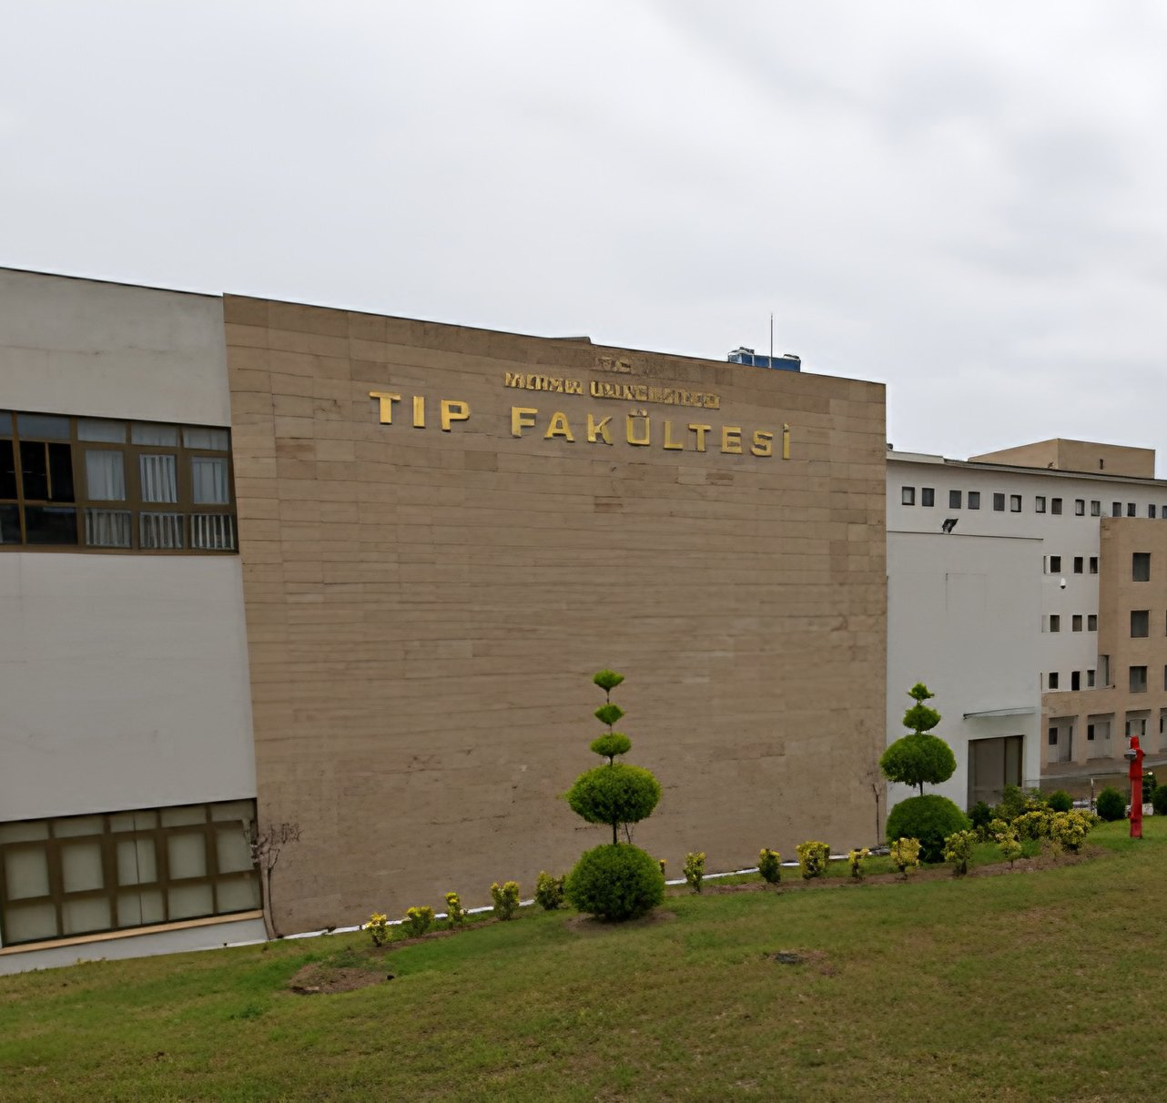


Faculty of Medicine
MERSIN UNIVERSITY
Introduction 2026
The right choice for a healthy future
October 2026

Slide 2
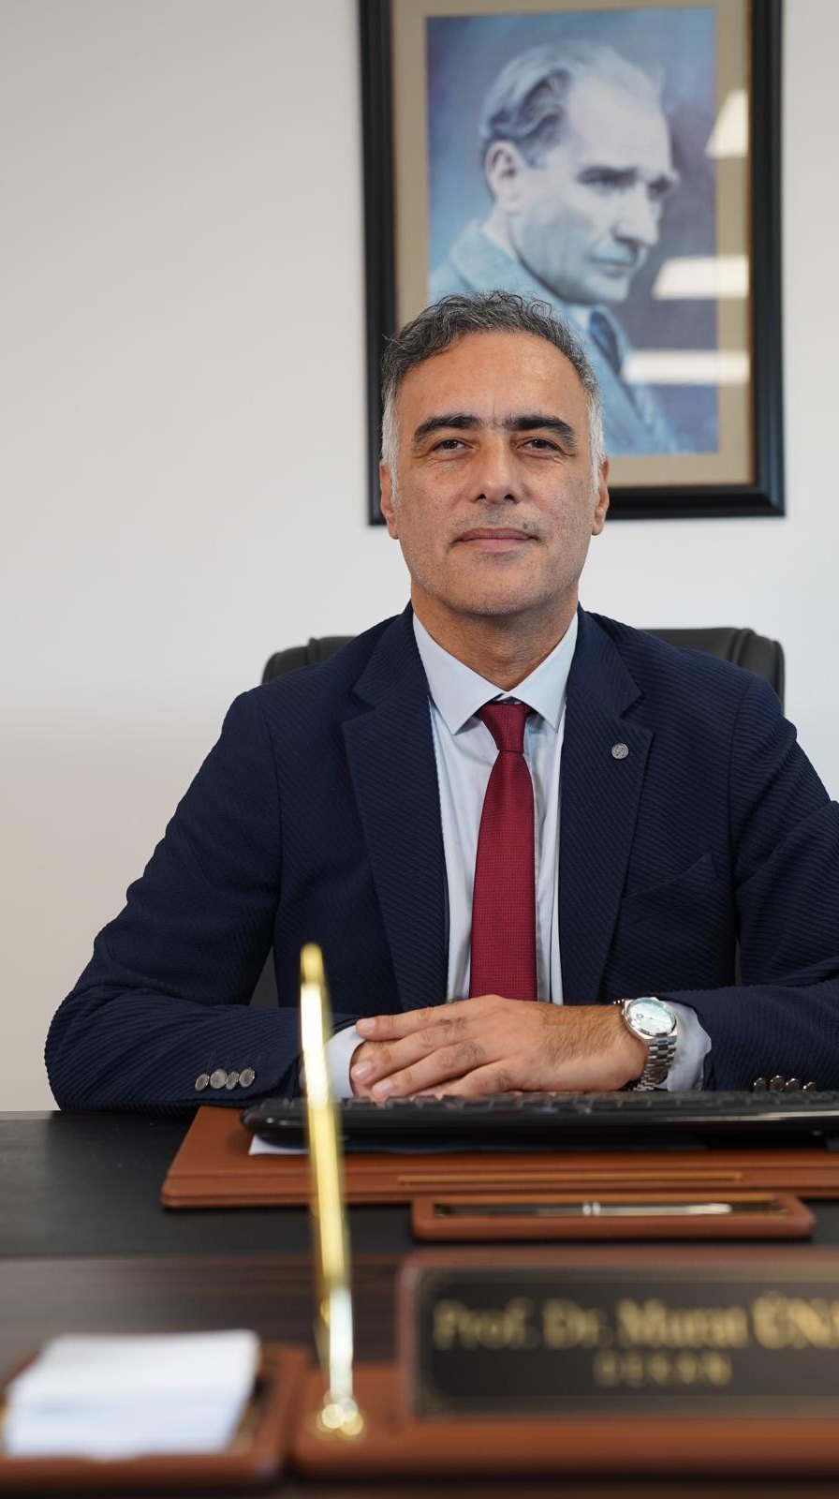




Science and people at the centre
DEAN'S MESSAGE
At Mersin University Faculty of Medicine, we build our approach to medical education on the guidance of science and a physician identity that puts people at the centre.
Our principles in education and healthcare
Holistic medicine
Education, scientific research and healthcare form a whole whose parts feed and strengthen each other.
Ethics and communication
We educate physicians who appraise evidence critically, listen to their patients, uphold ethical values and care about public health.
A culture of lifelong learning
We support a physician identity built on curiosity, research and lifelong learning.
Prof. Dr. Murat Ünal
The full message is on our website: About the Faculty > Dean's Message
Dean

Slide 3







Six reasons to choose our faculty
WHY MERSIN?
Quality education
Strong clinical training
Research and development
A modern programme with horizontal, vertical and spiral integration, aligned with UÇEP 2020
A wide range of patients at the 840-bed Mersin University Hospital
Modern laboratories and national and international projects
Experienced academic staff
International opportunities
Quality assurance
Expert, dynamic and student-centred faculty members
Erasmus and bilateral agreements with 10 medical faculties in 6 countries
ISO 9001 since 2003 and national accreditation valid until 2031
In the heart of the Mediterranean, a liveable city: Mersin

Slide 4
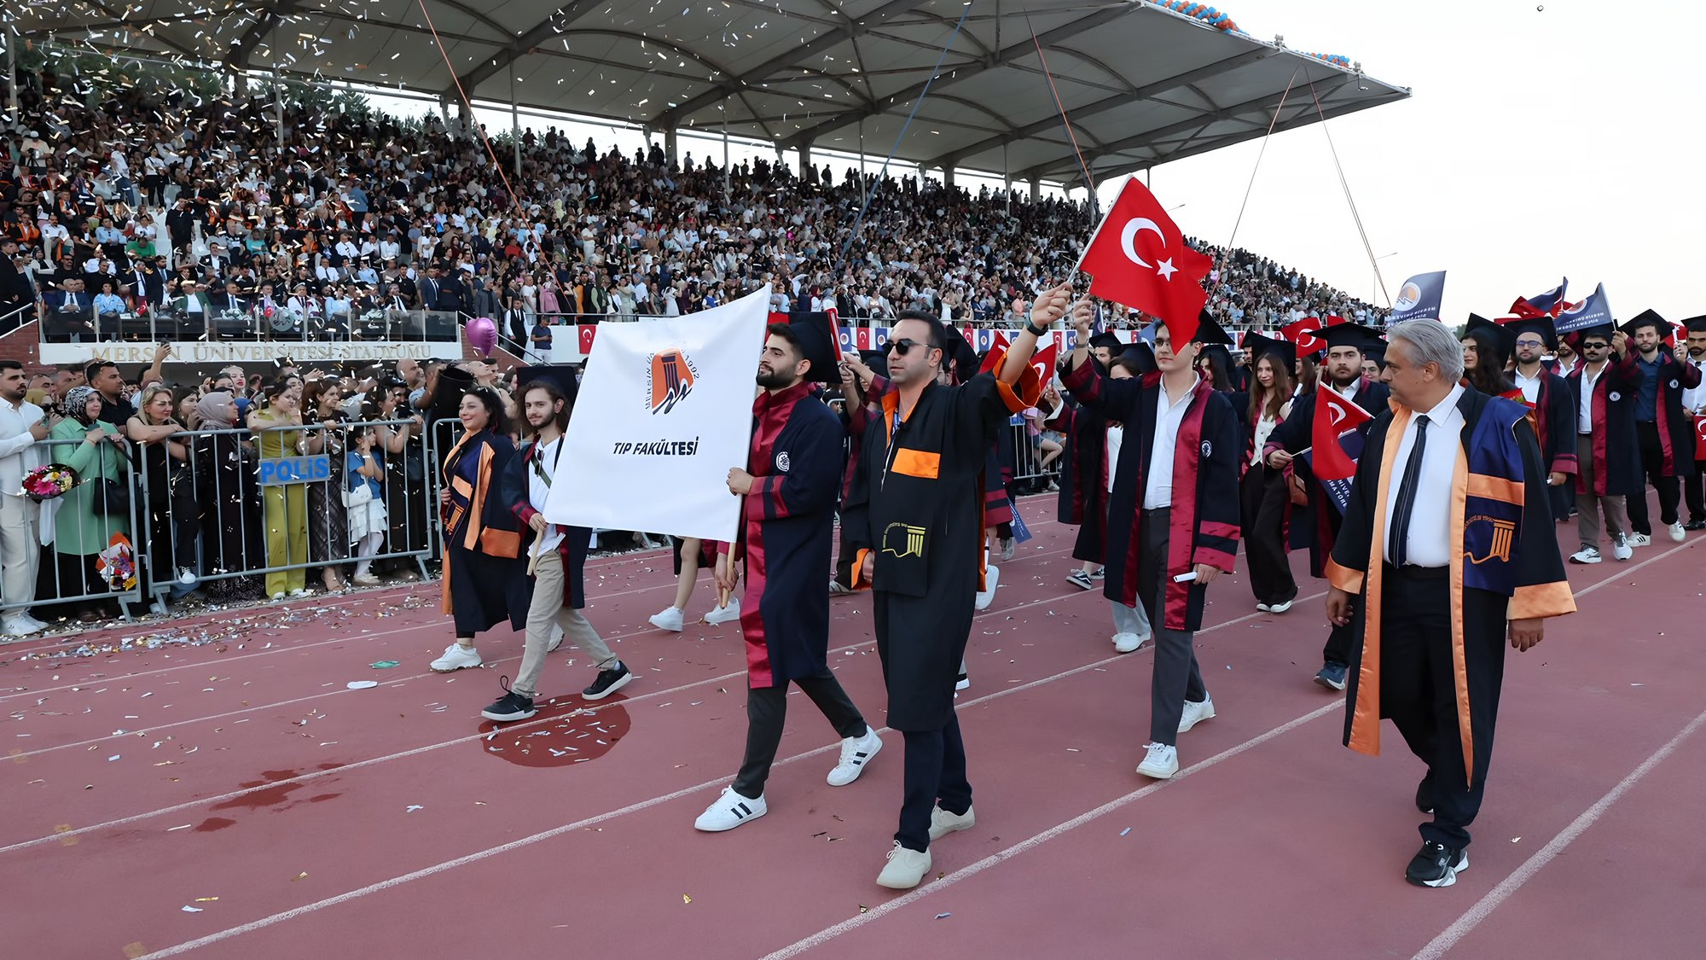
Our faculty in numbers
AT A GLANCE
1998
3,056
1,645
164
we began operating and admitted our first students
graduate physicians (23 classes)
students
professors, 42 associate and 44 assistant professors
42
840
27
2031
departments and 33 subdepartments
beds at our teaching hospital
countries of origin of our 204 international students
end of our current national accreditation
Faculty data, October 2026
Mersin University Faculty of Medicine · Introduction 2026

Slide 5
From our foundation to today
HISTORY
1992
1999
2004
2014
2025
Founding law (No. 3837)
First teaching hospital (200 beds)
Our first graduates
New hospital building in Çiftlikköy
Third accreditation, to 2031
1998
2003
2012
2020
2026
Start of operations, first 28 students
ISO 9001 quality management certificate
First national accreditation (UTEAK)
Oncology Hospital
23rd class: 253 new physicians, 3,056 in total

Slide 6



Continuity in quality
QUALITY AND ACCREDITATION
1ST PERIOD
2ND PERIOD
3RD PERIOD
2012-2018
2019-2025
2025-2031
First national accreditation
Renewed accreditation
Uninterrupted quality assurance
Our undergraduate medical programme has been accredited without interruption since 2012 by the National Medical Education Accreditation Board (UTEAK) of TEPDAD. Our faculty is one of thirteen faculties accredited for a third time under the 2022 TEPDAD standards.
Since 2003
3,056
TS EN ISO 9001 Quality Management System certificate
graduate physicians: 14 in our first class, 253 in 2026

Slide 7
3 divisions, 42 departments, 33 subdepartments
ACADEMIC STRUCTURE
Internal Medical Sciences
19 departments · 45%
Surgical Medical Sciences
13 departments · 31%
42
Basic Medical Sciences
10 departments · 24%
departments
Academic staff
164
42
44
professors
associate professors
assistant professors

Slide 8
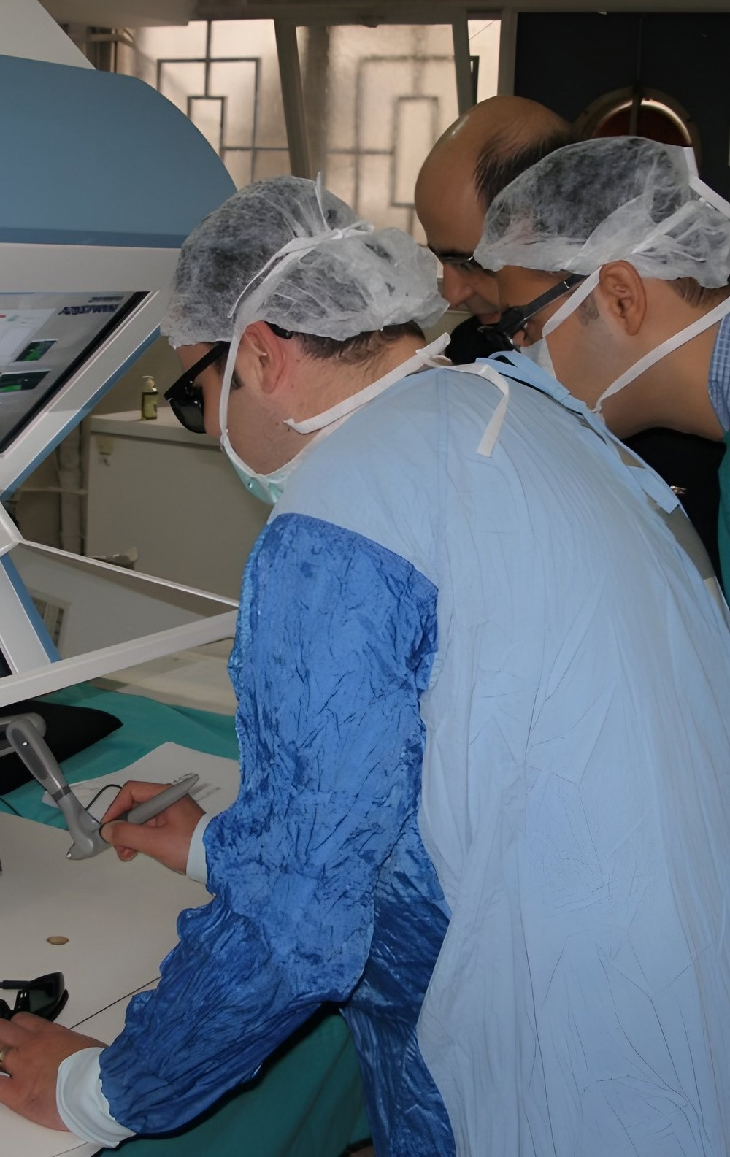
An integrated six-year programme
EDUCATION
YEARS 1-3
System-based integrated course blocks with clinical skills and communication skills training
Basic and preclinical education
YEARS 4-5
Clerkships in internal and surgical sciences, learning at the bedside and within the team
Clinical clerkships
YEAR 6
Hands-on responsibility in rotations including emergency medicine, family medicine and public health
Internship
Fully aligned with UÇEP 2020
Problem-based learning
Evidence-based and community-based medicine
Clinical skills training
Clinical skills training

Slide 9





TEAD: education managed in one digital system
DIGITAL EDUCATION MANAGEMENT
32 modules in 4 groups
8 modules
7 modules
8 modules
9 modules
Curriculum and teaching
Exams and assessment
Administration and advising
Systems, integration and projects
Curriculum management
Clinical and internship curricula
Core curriculum planning
Test blueprints
Training of trainers
Question bank
Exam management and invigilation
Formative exams
Item analysis and clinical exam scoring
Exam appeals
Academic and social advising
Surveys
Attendance tracking
Tasks and meetings
Events, appeals and feedback
API and integration
Announcements
Inventory tracking
Dictation and audio recording
AFGÖK, MESEKOK, İYİS and KUG modules
From curriculum planning and exams to advising, surveys and meetings, education processes are managed in one system.

Slide 10
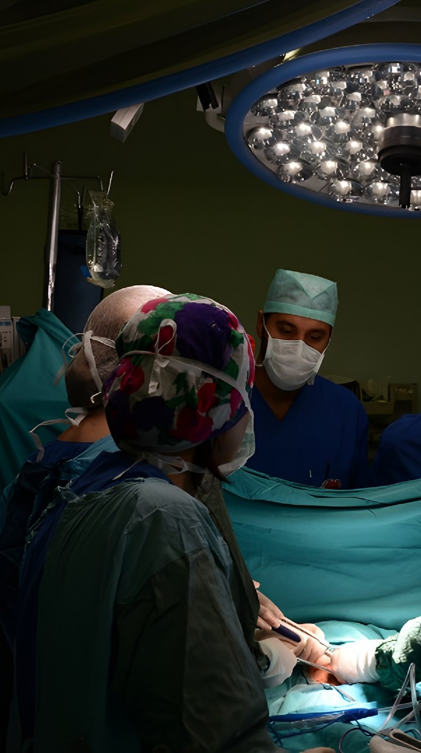
Accredited residency programmes
RESIDENCY TRAINING
As of 2026, residency training is accredited in 11 departments and subdepartments
01
Emergency Medicine
07
Cardiology
Critical care and emergency response training
Cardiovascular diagnosis and treatment
02
Algology (Pain Medicine)
08
Otorhinolaryngology
Advanced pain treatment and management
ENT and head and neck surgery
03
Anaesthesiology and Reanimation
09
Orthopaedics and Traumatology
ESAIC international accreditation
Comprehensive musculoskeletal surgery
04
General Surgery
10
Plastic, Reconstructive and Aesthetic Surgery
Comprehensive and oncological surgery
Advanced reconstruction and microsurgery
05
Thoracic Surgery
11
Radiology
Advanced thoracic and interventional training
Advanced medical imaging and diagnosis
06
Public Health
11
accredited residency programmes
Community health and epidemiology

Slide 11
Scientific output (2024-2026)
RESEARCH
Articles by year and division
1,243
articles (2024-2026)
805
indexed in SCI, SCI-E or SSCI (65%)
90
research projects, 42 of them international
* 2026 data as of October 2026. Source: faculty publication and project records.

Slide 12
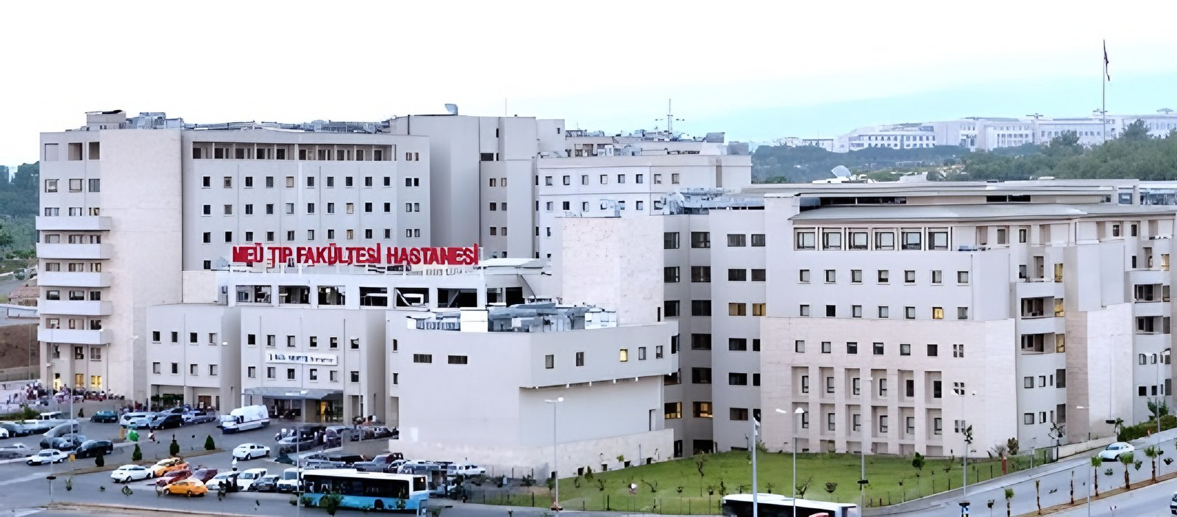
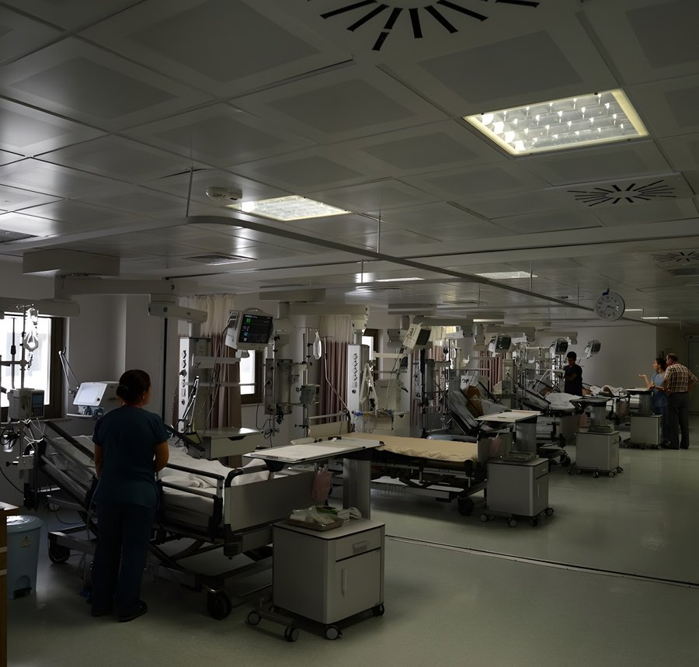
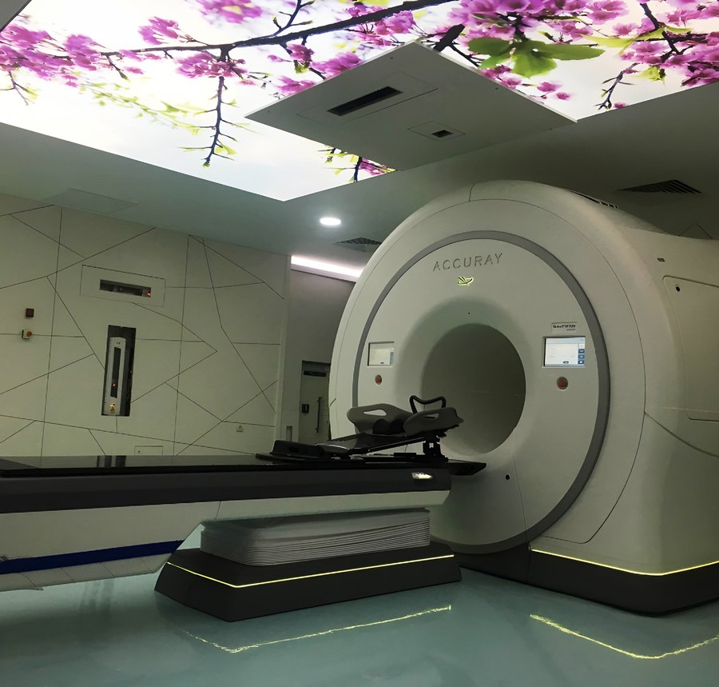
Mersin University Hospital
HEALTHCARE
840
2014
110,000 m²
2020
beds
in the new building on the Çiftlikköy Campus
total area
the Oncology Hospital opened
Our students receive their clinical training at our hospital, which provides advanced care to Mersin and the region.

Slide 13

Our admission rank is rising fast
PROSPECTIVE STUDENTS
Rank of the last admitted student
11,789
The axis is reversed: a rising line means a better rank.
cut-off rank (2026 YKS)
511.76
230
minimum score (2026)
places, all filled
Source: ÖSYM placement results, YÖK Atlas
A rise of 2,821 places in two years: 14,610 (2024) → 11,789 (2026)

Slide 14
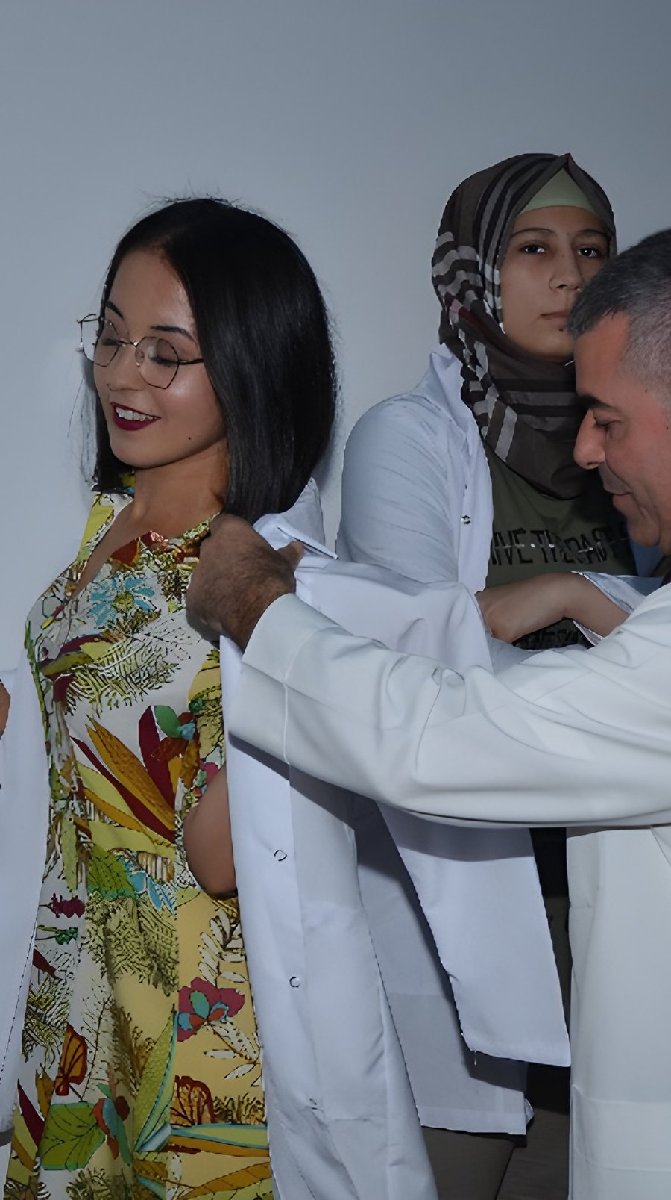

Our students
STUDENTS
1,645
students in our six-year medical programme
230
204
new students (2026 YKS, all places filled)
international students from 27 countries
253
6
new physicians (class of 2026)
active student societies
White coat ceremony

Slide 15
204 students from 27 countries
INTERNATIONAL STUDENTS
Top 10 countries of our international students
79%
from Azerbaijan, Iran and Syria (161 students)
24 → 34
new international students per year (2023-2025)
New enrolments
Students of non-Turkish nationality, 2025-2026

Slide 16
Erasmus and bilateral agreements
INTERNATIONAL COOPERATION
6 countries
10 medical faculties
Erasmus student mobility
Italy Foggia, Genoa, Naples, Pisa, Sapienza (Rome)
Germany Giessen
Russia Tyumen
Bulgaria Trakia
Tajikistan Avicenna
In three years, 15 outgoing and 12 incoming students; outgoing students rose from 4 to 6 a year.
Romania Galați

Slide 17
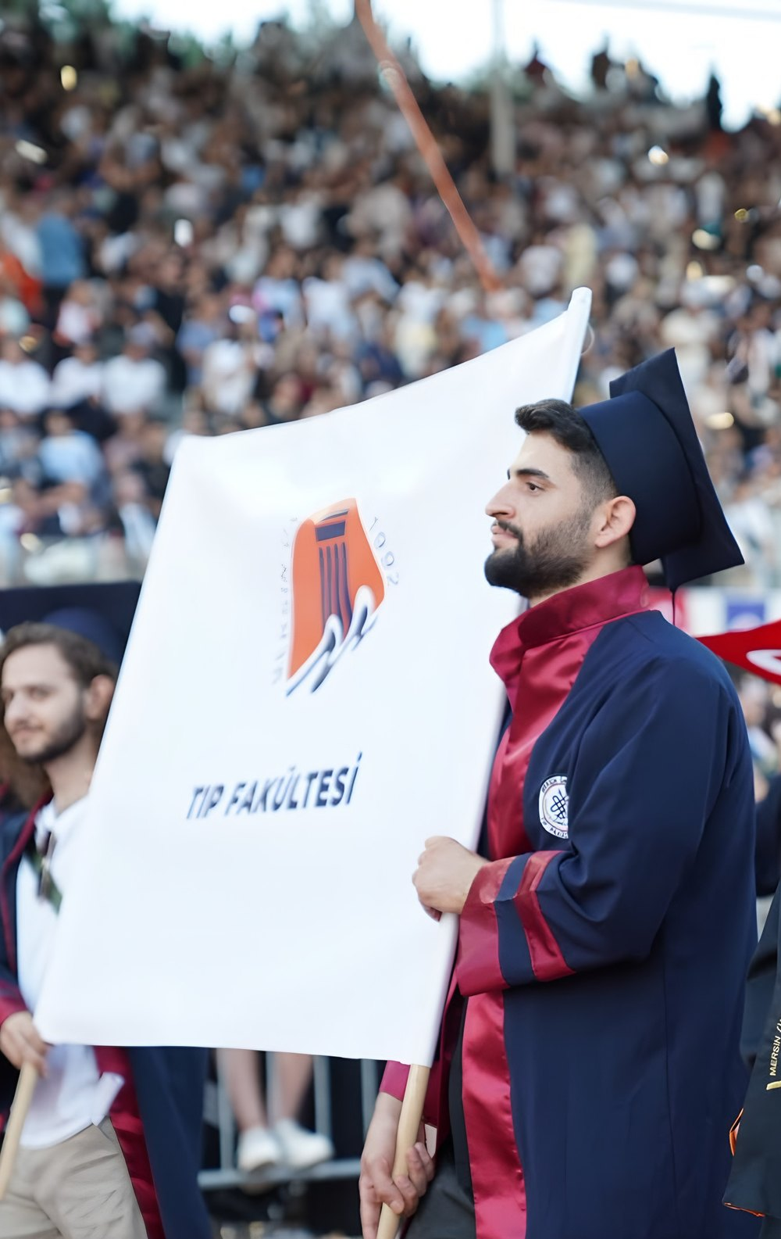
Academic achievement (2025-2026)
ACADEMIC ACHIEVEMENT
81-84%
97.19%
Pass rate in the preclinical years
Clinical clerkship success
Year 1: 81.17% · Year 2: 83.51% · Year 3: 83.02%
1,779 clerkship enrolments in 8 clinical departments
10 rotations
100%
with 100% success in Year 5
Internship (Year 6)
Other rotations: 96.82-99.17%
In all 8 rotations, 249-262 interns
Graduation procession

Slide 18
Satisfaction rises in the clinical years
STUDENT FEEDBACK
Overall satisfaction by year of study (%)
86%
overall satisfaction in Year 6
78-86%
satisfaction in the clinical years (4-6)
83-100%
overall satisfaction in Year 5 rotations
Source: 2025-2026 student satisfaction surveys

Slide 19






Our student societies
CAMPUS LIFE
Academic and research
International and exchange
Social responsibility
Scientific Research Society
TurkMSIC Mersin Local Committee
Leyla’dan Sonra Society
Developing research skills, organising congresses and symposia
Student exchange, public health and medical education projects
Making the wishes of children with cancer or chronic illness come true
Community health
Culture and arts
Ethics and history of medicine
Blood Donation Volunteers Society
Faculty of Medicine Art Society
History of Medicine and Deontology Society
Raising awareness and running regular blood drives
Engaging with the arts through social and artistic events
Readings, panels and talks on medical ethics, deontology and history

Slide 20
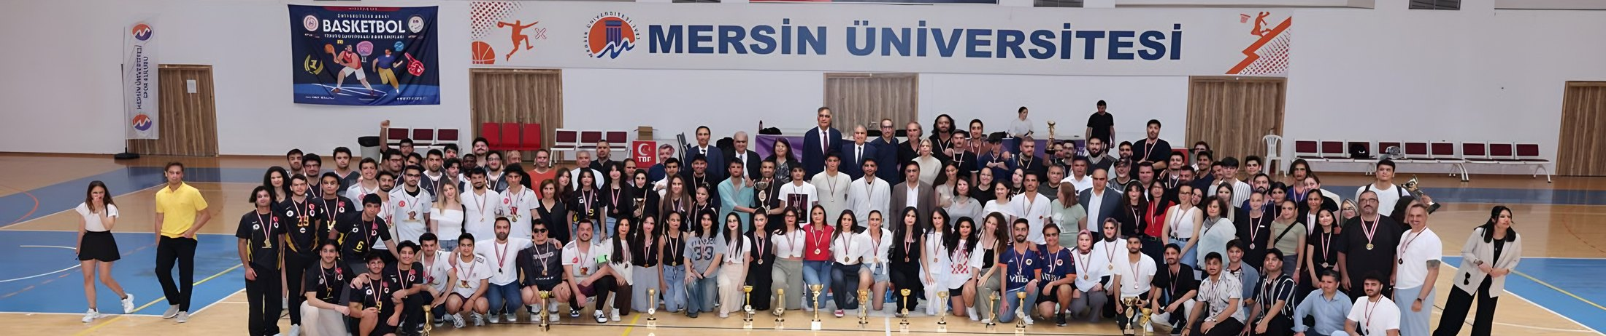



MEÜFEST 2026: two championships, five podiums
CAMPUS LIFE
CHAMPIONS
SECOND PLACE
THIRD PLACE
Student study hall
Men's football
Men's basketball
Men's volleyball
Women's volleyball
Women's basketball
120 seats, open 24/7
A new, well-equipped study hall with security-controlled access in the evening and at night

Slide 21



Scholarships and support (2025-2026)
SUPPORT
Civil society and institutional support
Meal support
Professional bodies
MÜGEV: regular lunch scholarships for 18 students
TTB, KAHEV and the Chamber of Commerce
Local government
Student
Metropolitan Municipality
Special needs support
Health foundations
Turkish Kidney Foundation, Turkish Cardiology Foundation
TESYEV: full support for our student with special needs
Service clubs
Lions and Rotary clubs

Slide 22



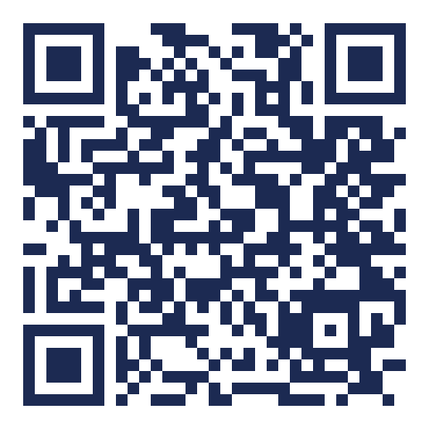



Our social media accounts
FOLLOW US
Instagram
X
Facebook
@meutipfakultesi
@meutipfakultesi
MEÜ Tıp Fakültesi
YouTube
LinkedIn
N
NSosyal
Our website
@meutipfakultesi
meutipfakultesi
@meutipfakultesi
Scan the code with your phone camera
Our website: www2.mersin.edu.tr/en/academic/faculty-of-medicine
Follow our official accounts for announcements, events and news.

Slide 23
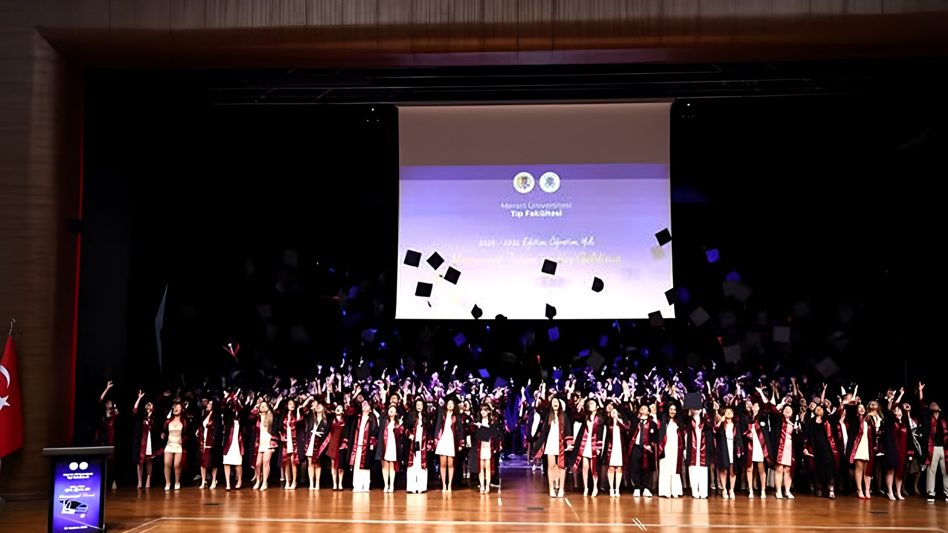
welcomes you to the family
MERSIN UNIVERSITY FACULTY OF MEDICINE
“Entrust me to Turkish physicians.”
Mustafa Kemal Atatürk
Thank you

